Slide 1
Analog Communication
UNIT – III
Tweneboah-Koduah Samuel
Made by: Hridesh Vishwdewa

Slide 2
AC4D
Modulation Fundamentals

Slide 3
Note: The following topics are left for later consideration or treatment.
However, students are encouraged to read about them.
Power Spectra Density (PSD)
Energy Spectra Density (ESD)
Noise Equivalent Bandwidth
Ergodic Process
Frequency Response of LTI systems
Sampling Theorem
Fourier Series and Transform

Slide 4
Modulation Techniques

Slide 5
Frequency translation
Suppose that a signal is bandlimited to the frequency range extending from a frequency f1 to f2.
Frequency translation is used to replace the signal with a new signal whose spectral range extends from f1’ to f2’ and has a recoverable form the same info as was within the original

Slide 6
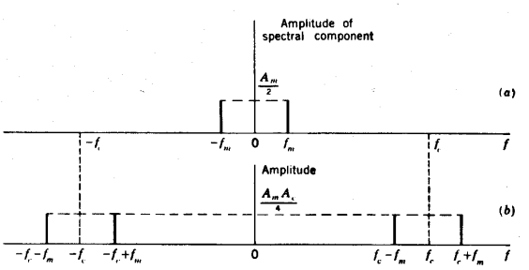
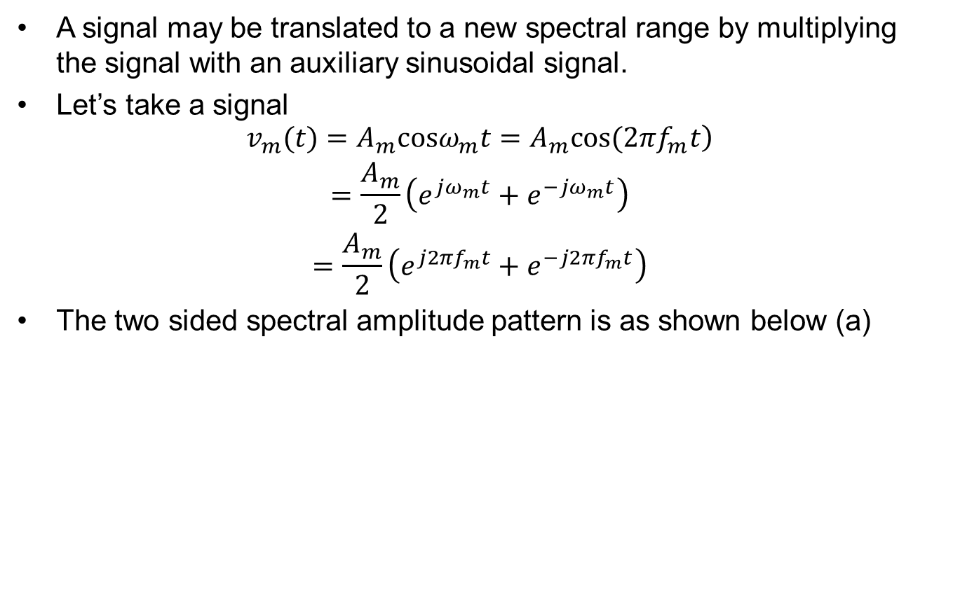
Method of frequency translation
A signal may be translated to a new spectral range by multiplying the signal with an auxiliary sinusoidal signal.
Let’s take a signal
$$\begin{matrix}\left.v_{m}(t)=A_{m}cosω_{m}t=A_{m}cos(2πf_{m}t\right) \\ \begin{aligned}=\frac{A_{m}}{2}\left(e^{jω_{m}t}+e^{−jω_{m}t}\right) \\ =\frac{A_{m}}{2}\left(e^{j2πf_{m}t}+e^{−j2πf_{m}t}\right)\end{aligned}\end{matrix}$$
The two sided spectral amplitude pattern is as shown below (a)
Euler’s theorem
Notes:
Where Am is the constant amplitude

Slide 7
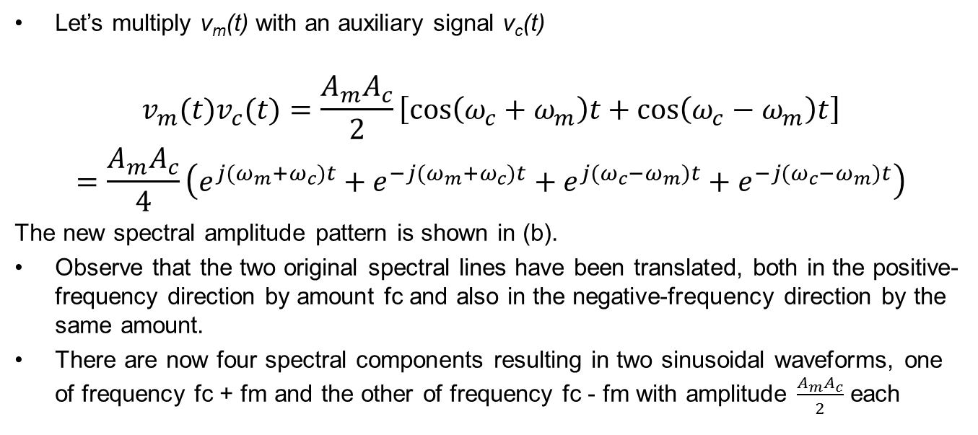
Method of frequency translation
Let’s multiply v_{m}(t) with an auxiliary signal v_{c}(t)
$$\begin{matrix}v_{m}(t)v_{c}(t)=\frac{A_{m}A_{c}}{2}\left[cos\left(ω_{c}+ω_{m}\right)t+cos\left(ω_{c}−ω_{m}\right)t\right] \\ =\frac{A_{m}A_{c}}{4}\left(e^{j(ω_{m}+ω_{c})t}+e^{−j(ω_{m}+ω_{c})t}+e^{j(ω_{c}−ω_{m})t}+e^{−j(ω_{c}−ω_{m})t}\right)\end{matrix}$$
The new spectral amplitude pattern is shown in (b).
Observe that the two original spectral lines have been translated, both in the positive-frequency direction by amount fc and also in the negative-frequency direction by the same amount.
There are now four spectral components resulting in two sinusoidal waveforms, one of frequency fc + fm and the other of frequency fc - fm with amplitude $\frac{A_{m}A_{c}}{2}$ each
Notes:
Fourier transform can be used to achieve the same results

Slide 8
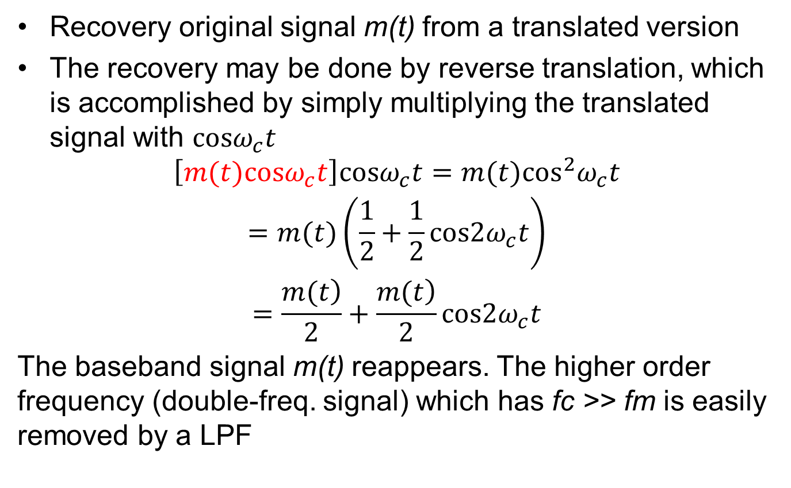
Recovery of the baseband signal
Recovery original signal m(t) from a translated version
The recovery may be done by reverse translation, which is accomplished by simply multiplying the translated signal with $cosω_{c}t$
$$\begin{matrix}\begin{aligned}\left[m(t)cosω_{c}t\right]cosω_{c}t=m(t)\cos^{2}ω_{c}t \\ =m(t)\left(\frac{1}{2}+\frac{1}{2}cos2ω_{c}t\right)\end{aligned} \\ =\frac{\left.m(t\right)}{2}+\frac{\left.m(t\right)}{2}cos2ω_{c}t\end{matrix}$$
The baseband signal m(t) reappears. The higher order frequency (double-freq. signal) which has fc >> fm is easily removed by a LPF
Notes:
$$\begin{matrix}\left[m(t)cosω_{c}t\right]cosω_{c}t=m(t)\cos^{2}ω_{c}t=m(t)\left(\frac{1}{2}+\frac{1}{2}cos2ω_{c}t\right) \\ =\frac{\left.m(t\right)}{2}+\frac{\left.m(t\right)}{2}cos2ω_{c}t\end{matrix}$$

Slide 9
Modulation Fundamentals

Slide 10
Modulation fundamental
Before an information-bearing signal is transmitted through a communication channel, some type of modulation process is typically utilized to produce a signal that can easily be accommodated by the channel.
The modulation process commonly translates an information-bearing signal, usually referred to as the message signal, to a new spectral location depending upon the intended frequency for transmission.
Multiplexing allows two or more message signals to be transmitted by a single transmitter and received by a single receiver simultaneously.
The two basic types of analog modulation are continuous-wave modulation and pulse modulation. In continuous-wave modulation, a parameter of a high-frequency carrier is varied proportionally to the message signal such that a one-to-one correspondence exists between the parameter and the message signal.

Slide 11
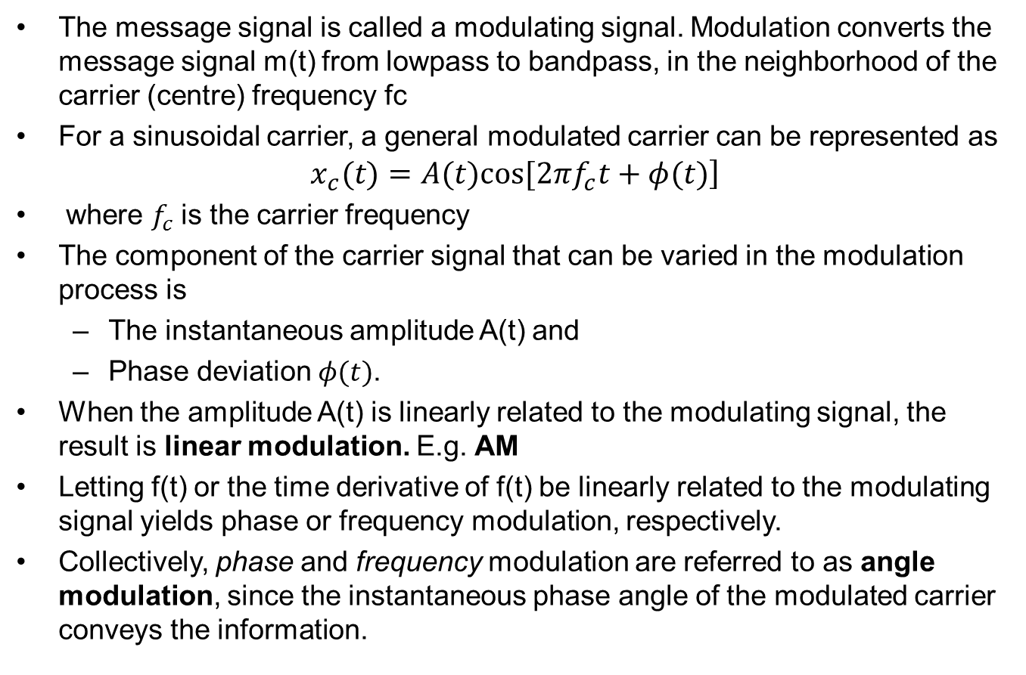
Modulation fundamental
The message signal is called a modulating signal. Modulation converts the message signal m(t) from lowpass to bandpass, in the neighborhood of the carrier (centre) frequency fc
For a sinusoidal carrier, a general modulated carrier can be represented as
$$\left.x_{c}(t)=A(t)cos[2πf_{c}t+φ(t)\right]$$
where $f_{c}$ is the carrier frequency
The component of the carrier signal that can be varied in the modulation process is
The instantaneous amplitude A(t) and
Phase deviation $φ(t)$.
When the amplitude A(t) is linearly related to the modulating signal, the result is linear modulation. E.g. AM
Letting f(t) or the time derivative of f(t) be linearly related to the modulating signal yields phase or frequency modulation, respectively.
Collectively, phase and frequency modulation are referred to as angle modulation, since the instantaneous phase angle of the modulated carrier conveys the information.

Slide 12
Modulation fundamental
Modulation is the process of changing some characteristics (amplitude, frequency and phase) of carrier wave in accordance with the instantaneous value of the modulating signal m(t)
Types of modulation
Amplitude modulation
Frequency modulation
Phase modulation

Slide 13
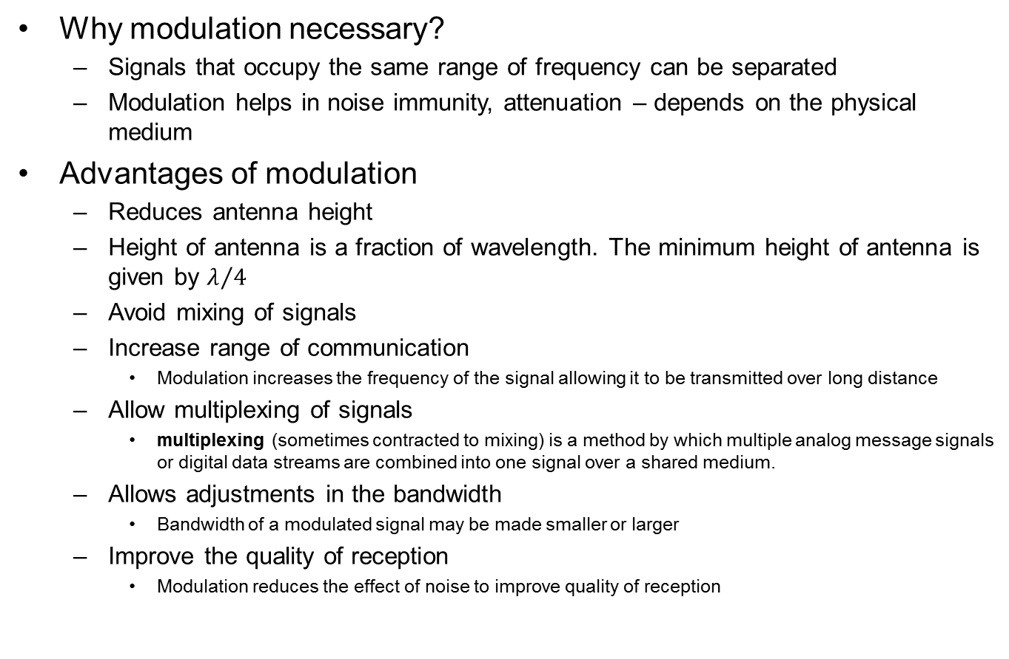
Modulation fundamental
Why modulation necessary?
Signals that occupy the same range of frequency can be separated
Modulation helps in noise immunity, attenuation – depends on the physical medium
Advantages of modulation
Reduces antenna height
Height of antenna is a fraction of wavelength. The minimum height of antenna is given by $λ/4$
Avoid mixing of signals
Increase range of communication
Modulation increases the frequency of the signal allowing it to be transmitted over long distance
Allow multiplexing of signals
multiplexing (sometimes contracted to mixing) is a method by which multiple analog message signals or digital data streams are combined into one signal over a shared medium.
Allows adjustments in the bandwidth
Bandwidth of a modulated signal may be made smaller or larger
Improve the quality of reception
Modulation reduces the effect of noise to improve quality of reception
Notes:
$$λ/4$$

Slide 14
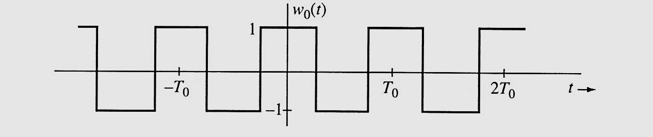
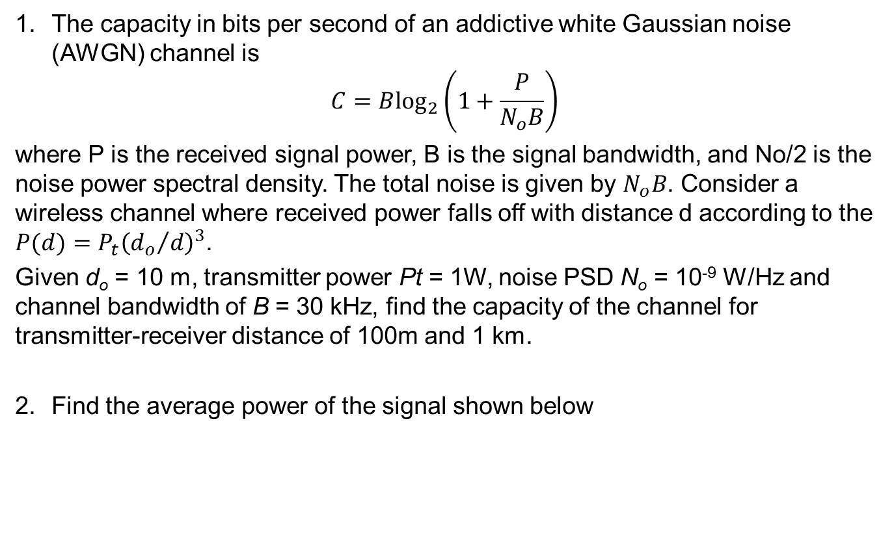
Assignment
The capacity in bits per second of an addictive white Gaussian noise (AWGN) channel is
$$C=B\log_{2}\left(1+\frac{P}{N_{o}B}\right)$$
where P is the received signal power, B is the signal bandwidth, and No/2 is the noise power spectral density. The total noise is given by $N_{o}B$. Consider a wireless channel where received power falls off with distance d according to the $P(d)=P_{t}{\left({d_{o}}/d\right)}^{3}$.
Given d_{o} = 10 m, transmitter power Pt = 1W, noise PSD N_{o} = 10⁻⁹ W/Hz and channel bandwidth of B = 30 kHz, find the capacity of the channel for transmitter-receiver distance of 100m and 1 km.
Find the average power of the signal shown below

Slide 15
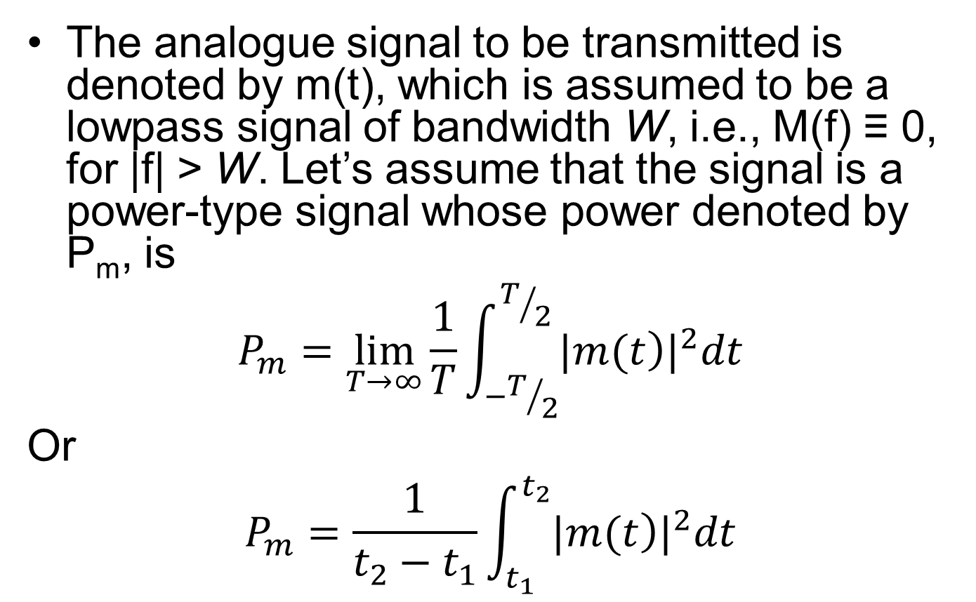
Amplitude modulation (AM)
The analogue signal to be transmitted is denoted by m(t), which is assumed to be a lowpass signal of bandwidth W, i.e., M(f) ≡ 0, for |f| > W. Let’s assume that the signal is a power-type signal whose power denoted by P_{m}, is
$$P_{m}=\lim_{T→∞}\frac{1}{T}\int_{−T/2}^{T/2}{{|\left.m(t\right)|}^{2}dt}$$
Or
$$P_{m}=\frac{1}{t_{2}−t_{1}}\int_{t_{1}}^{t_{2}}{{|\left.m(t\right)|}^{2}dt}$$
Finite periodic signal

Slide 16
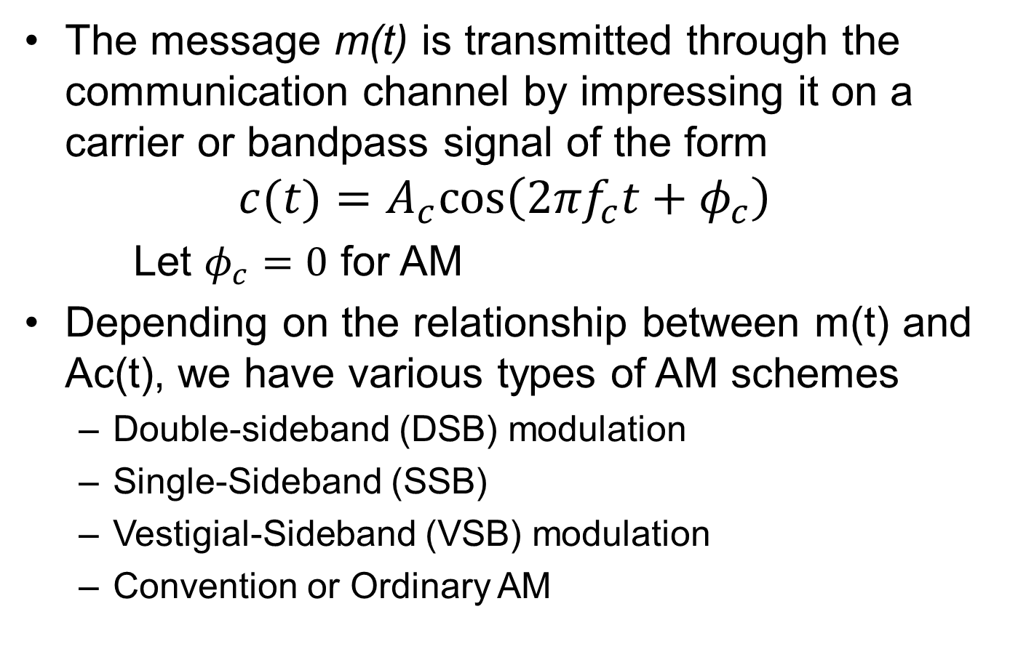
Amplitude modulation (AM)
The message m(t) is transmitted through the communication channel by impressing it on a carrier or bandpass signal of the form
$$c(t)=A_{c}cos\left(2πf_{c}t+φ_{c}\right)$$
Let $φ_{c}=0$ for AM
Depending on the relationship between m(t) and Ac(t), we have various types of AM schemes
Double-sideband (DSB) modulation
Single-Sideband (SSB)
Vestigial-Sideband (VSB) modulation
Convention or Ordinary AM
Notes:
$$g(t)=A_{c}\left[\left.1+m(t\right)\right]$$

Slide 17
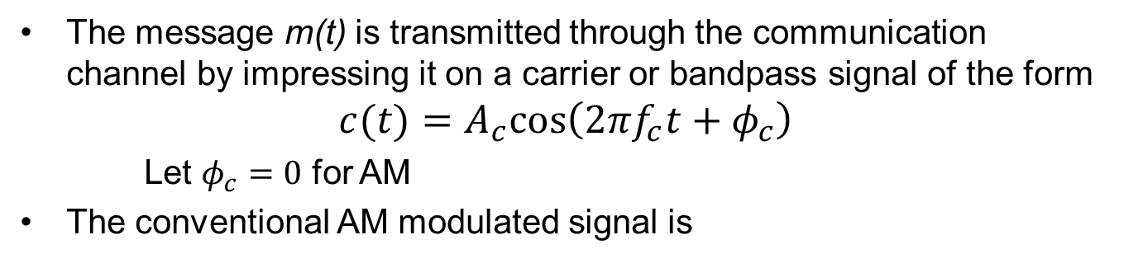
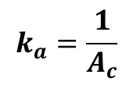
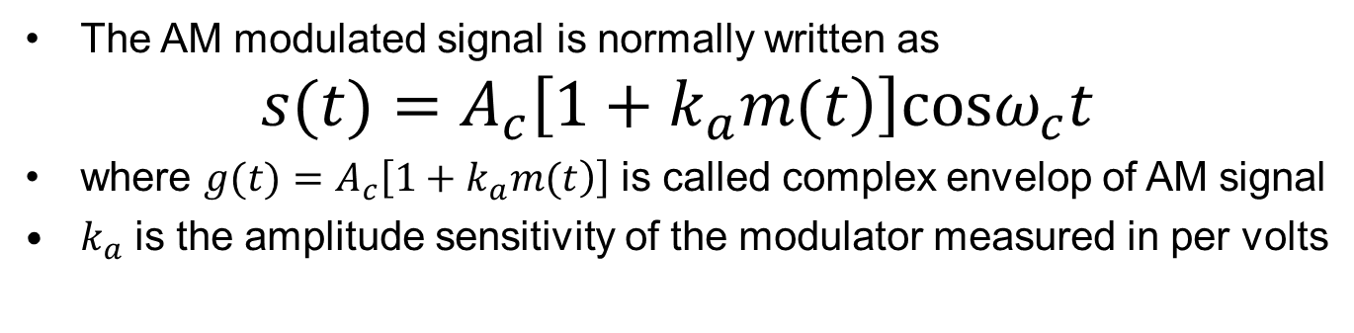
Amplitude modulation (AM)
The message m(t) is transmitted through the communication channel by impressing it on a carrier or bandpass signal of the form
$$c(t)=A_{c}cos\left(2πf_{c}t+φ_{c}\right)$$
Let $φ_{c}=0$ for AM
The conventional AM modulated signal is
The AM modulated signal is normally written as
$$s(t)=A_{c}\left[\left.1+k_{a}m(t\right)\right]cosω_{c}t$$
where $g(t)=A_{c}\left[\left.1+k_{a}m(t\right)\right]$ is called complex envelop of AM signal
$k_{a}$ is the amplitude sensitivity of the modulator measured in per volts
$$k_{a}=\frac{1}{A_{c}}$$

Slide 18
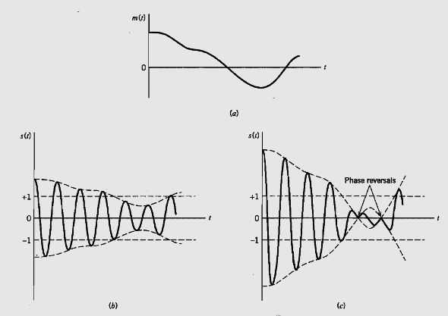
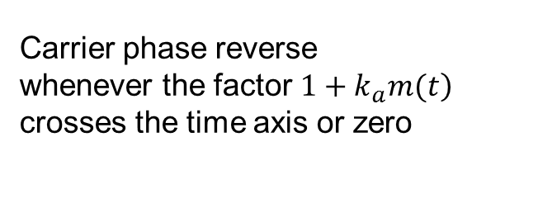
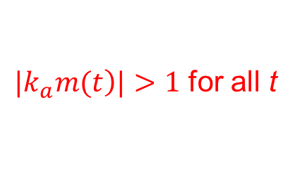
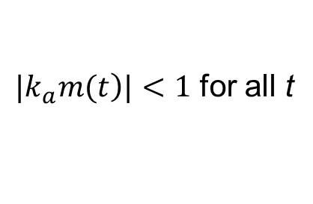
Amplitude modulation (AM)
Effects of ka – the modulation sensitivity
$|\left.k_{a}m(t\right)|<1$ for all t
$|\left.k_{a}m(t\right)|>1$ for all t
For all t, we overmodulation
Carrier phase reverse whenever the factor $\left.1+k_{a}m(t\right)$ crosses the time axis or zero
Notes:
$|\left.k_{a}m(t\right)|>1$ for all t, the carrier becomes over modulated resulting in carrier phase reversal whenever the factor $\left.1+k_{a}m(t\right)$ crosses the time axis or zero

Slide 19
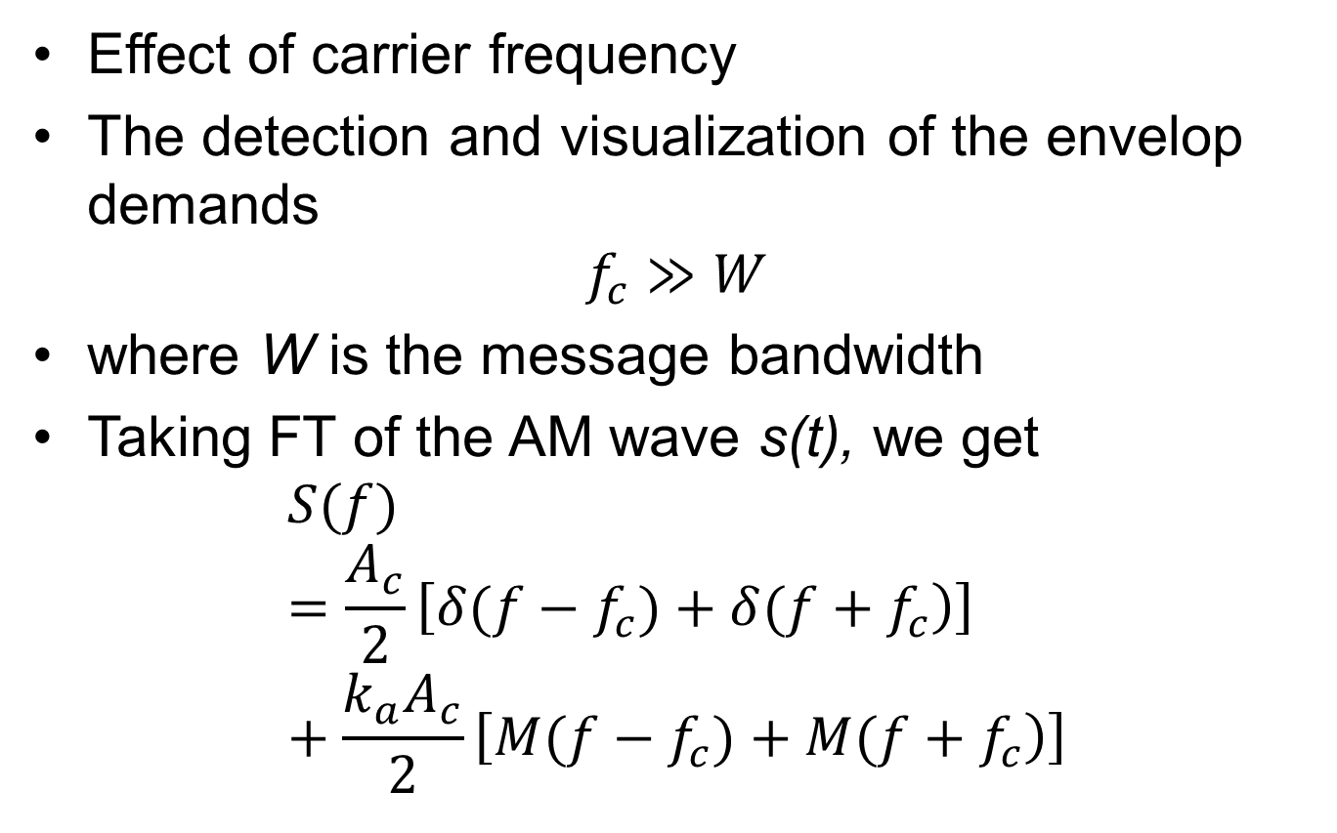
Amplitude modulation (AM)
Effect of carrier frequency
The detection and visualization of the envelop demands
$$f_{c}≫W$$
where W is the message bandwidth
Taking FT of the AM wave s(t), we get
$$S(f)=\frac{A_{c}}{2}\left[\left.δ(f−f_{c})+δ(f+f_{c}\right)\right]+\frac{k_{a}A_{c}}{2}\left[\left.M(f−f_{c})+M(f+f_{c}\right)\right]$$

Slide 20
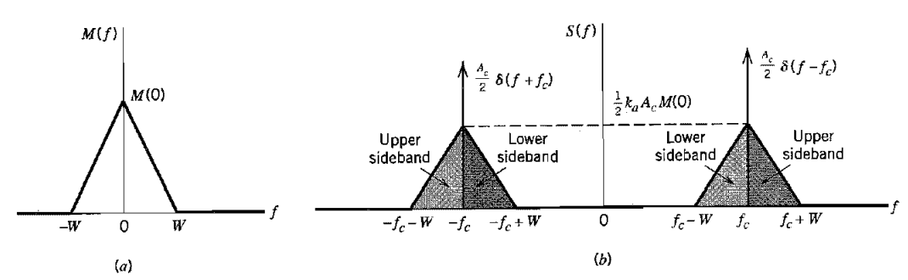
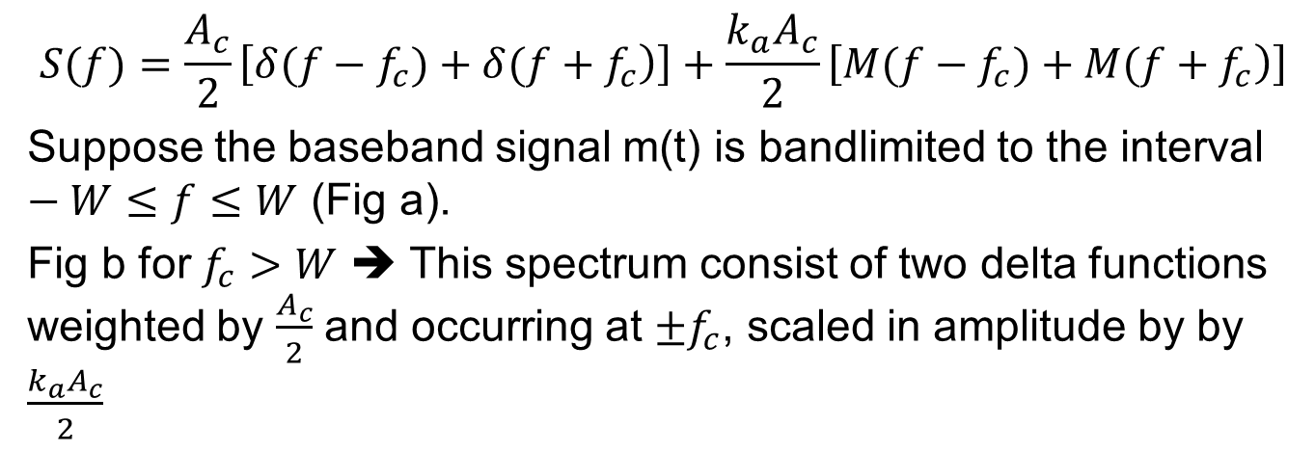
Amplitude modulation (AM)
$$S(f)=\frac{A_{c}}{2}\left[\left.δ(f−f_{c})+δ(f+f_{c}\right)\right]+\frac{k_{a}A_{c}}{2}\left[\left.M(f−f_{c})+M(f+f_{c}\right)\right]$$
Suppose the baseband signal m(t) is bandlimited to the interval $−W≤f≤W$ (Fig a).
Fig b for $f_{c}>W$ ➔ This spectrum consist of two delta functions weighted by $\frac{A_{c}}{2}$ and occurring at $±f_{c}$, scaled in amplitude by by $\frac{k_{a}A_{c}}{2}$
Notes:
$$±f_{c}$$

Slide 21
Example
A 1.4-MHz carrier is modulated by a music signal that has frequency components from 20 Hz to 15 kHz. Determine the range of frequencies generated for the upper and lower sidebands.
Solution
The upper side band is equal to the sum of carrier and intelligence frequencies. Therefore, the upper side band (usb) will include the frequencies from

Slide 22
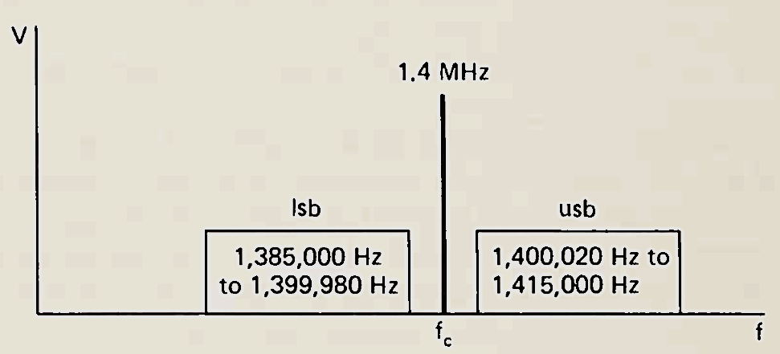
Example
A 1.4-MHz carrier is modulated by a music signal that has frequency components from 20 Hz to 15 kHz. Determine the range of frequencies generated for the upper and lower sidebands.
Solution
The upper side band is equal to the sum of carrier and intelligence frequencies. Therefore, the upper side band (usb) will include the frequencies from

Slide 23
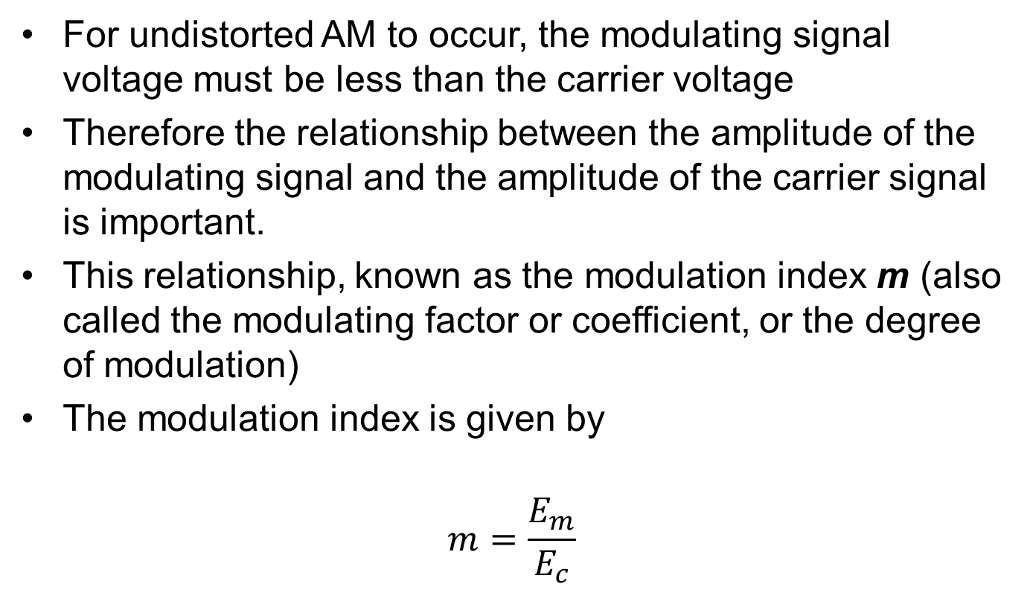
AM modulation index
For undistorted AM to occur, the modulating signal voltage must be less than the carrier voltage
Therefore the relationship between the amplitude of the modulating signal and the amplitude of the carrier signal is important.
This relationship, known as the modulation index m (also called the modulating factor or coefficient, or the degree of modulation)
The modulation index is given by
$$m=\frac{E_{m}}{E_{c}}$$
Notes:
The ratio of change in amplitude of modulating signal to the amplitude of carrier wave is know as modulation index or factor

Slide 24
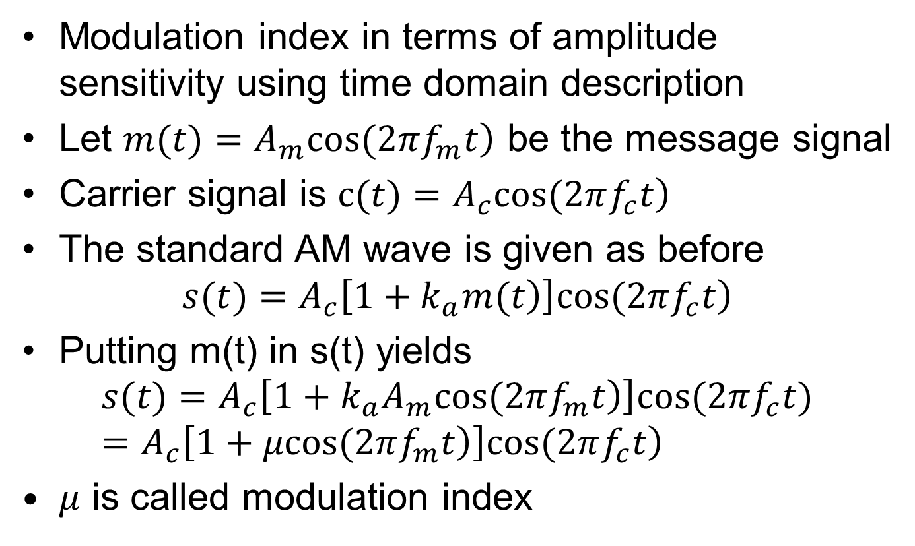
AM modulation index
Modulation index in terms of amplitude sensitivity using time domain description
Let $\left.m(t)=A_{m}cos(2πf_{m}t\right)$ be the message signal
Carrier signal is $\left.c(t)=A_{c}cos(2πf_{c}t\right)$
The standard AM wave is given as before
$$\left.s(t)=A_{c}\left[\left.1+k_{a}m(t\right)\right]cos(2πf_{c}t\right)$$
Putting m(t) in s(t) yields
$$\left.s(t)=A_{c}\left[\left.1+k_{a}A_{m}cos(2πf_{m}t\right)\right]cos(2πf_{c}t)=A_{c}\left[\left.1+μcos(2πf_{m}t\right)\right]cos(2πf_{c}t\right)$$
$μ$ is called modulation index
Eqn1
Notes:
Expanding eqn-1
$$\left.s(t)=A_{c}cos(2πf_{c}t)+μA_{c}cos(2πf_{c}t)·cos(2πf_{m}t\right)$$
and using trig identities →
$$cosAcosB=\frac{1}{2}\left[\left.cos(A−B)+cos(A+B\right)\right]$$
The results consist of three frequency components

Slide 25
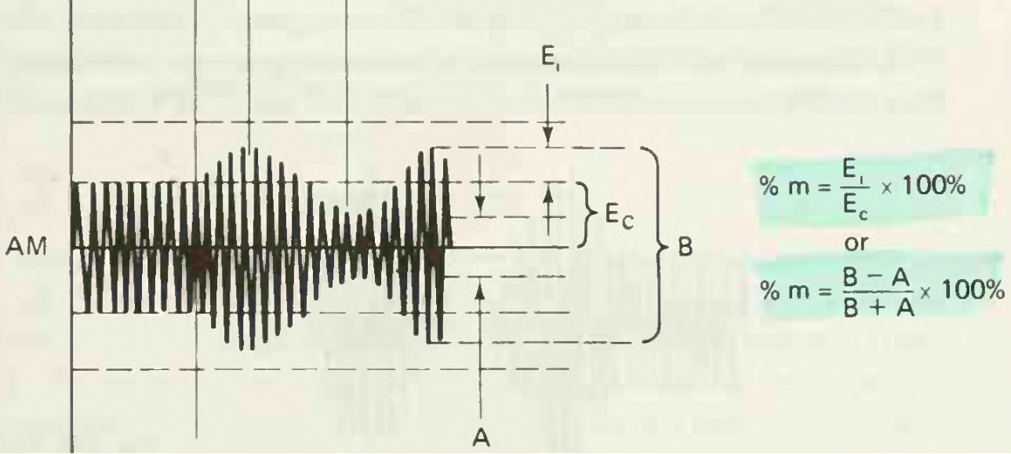
AM modulation index
Let Ei = Em, B = Emax, A = Emin
Emax is the maximum voltage peak-to-peak AM signal
Emin is the minimum voltage peak-to-peak AM signal
m is the modulation index

Slide 26
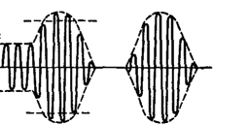
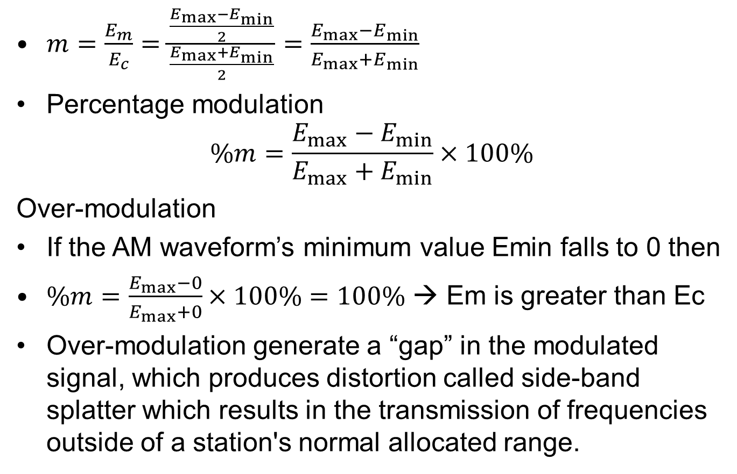
AM modulation index
$m=\frac{E_{m}}{E_{c}}=\frac{\frac{E_{max}−E_{min}}{2}}{\frac{E_{max}+E_{min}}{2}}=\frac{E_{max}−E_{min}}{E_{max}+E_{min}}$
Percentage modulation
$$\%m=\frac{E_{max}−E_{min}}{E_{max}+E_{min}}×100\%$$
Over-modulation
If the AM waveform’s minimum value Emin falls to 0 then
$\%m=\frac{E_{max}−0}{E_{max}+0}×100\%=100\%$ → Em is greater than Ec
Over-modulation generate a “gap” in the modulated signal, which produces distortion called side-band splatter which results in the transmission of frequencies outside of a station's normal allocated range.

Slide 27
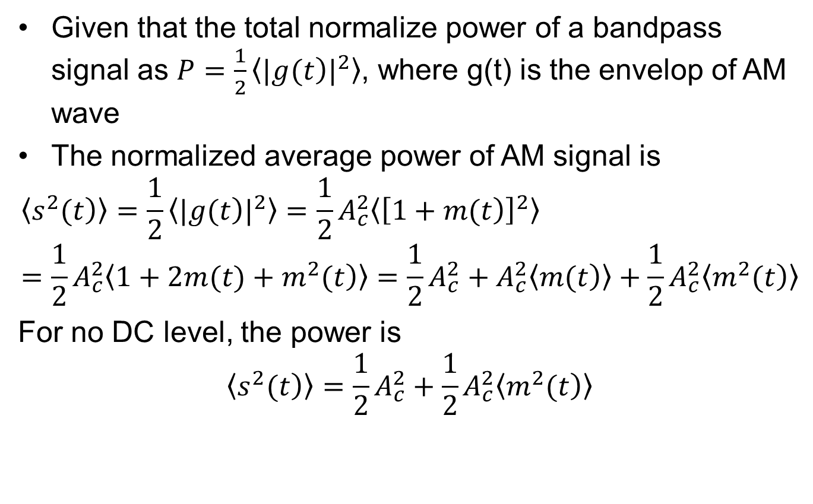
AM power and efficiency
Given that the total normalize power of a bandpass signal as $P=\frac{1}{2}〈{|\left.g(t\right)|}^{2}〉$, where g(t) is the envelop of AM wave
The normalized average power of AM signal is
$$〈\left.s^{2}(t\right)〉=\frac{1}{2}〈{|\left.g(t\right)|}^{2}〉=\frac{1}{2}A_{c}^{2}〈{\left[\left.1+m(t\right)\right]}^{2}〉=\frac{1}{2}A_{c}^{2}〈\left.1+2m(t)+m^{2}(t\right)〉=\frac{1}{2}A_{c}^{2}+A_{c}^{2}〈\left.m(t\right)〉+\frac{1}{2}A_{c}^{2}〈\left.m^{2}(t\right)〉$$
For no DC level, the power is
$$〈\left.s^{2}(t\right)〉=\frac{1}{2}A_{c}^{2}+\frac{1}{2}A_{c}^{2}〈\left.m^{2}(t\right)〉$$
Carrier power, Pc
Sideband power, Ps

Slide 28
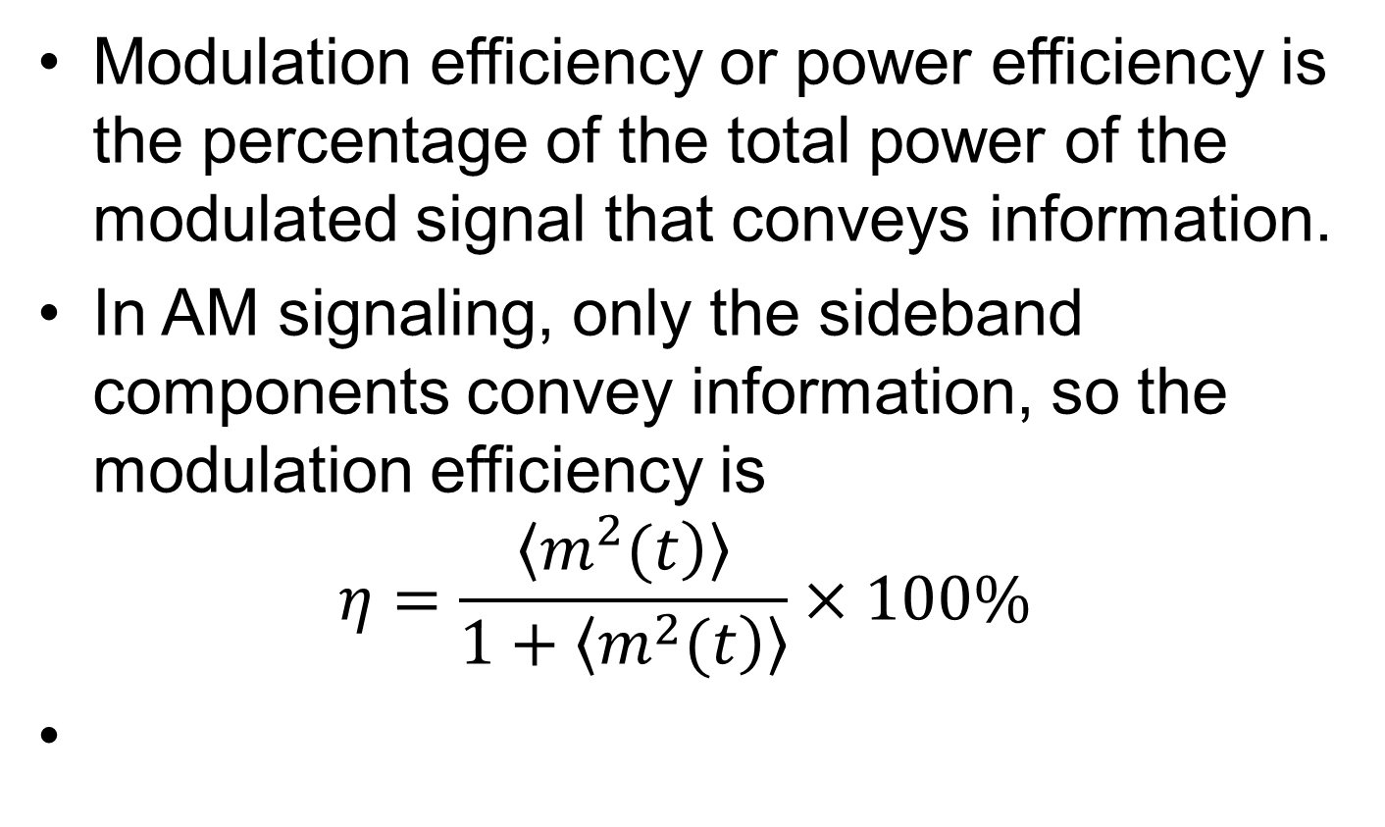
AM power and efficiency
Modulation efficiency or power efficiency is the percentage of the total power of the modulated signal that conveys information.
In AM signaling, only the sideband components convey information, so the modulation efficiency is
$$η=\frac{〈\left.m^{2}(t\right)〉}{1+〈\left.m^{2}(t\right)〉}×100\%$$

Slide 29
Example
A carrier wave of frequency 15 MHz and peak value 15 V is amplitude by a 5 KHz sine wave of amplitude 8 V. Find the modulation index and draw the corresponding spectrum
Notes:
Continue from handout page 50

Slide 30
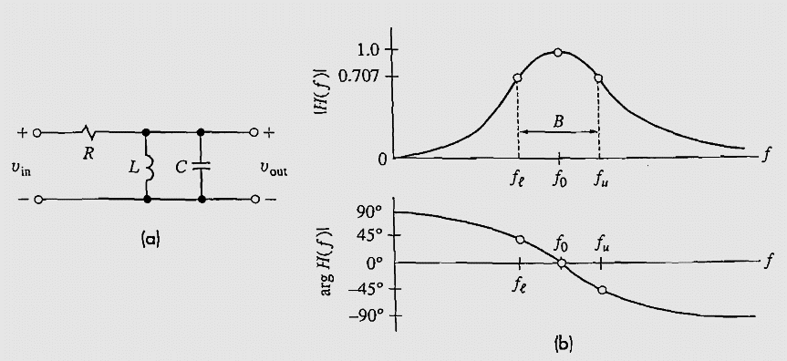
Bandpass transmission system
Bandpass signal xbp(t) applied to a bandpass system with transfer function H_{bp}( f ) produces the bandpass output y_{bp}(t)
The simplest bandpass system is the parallel resonant or tuned circuit represented

Slide 31
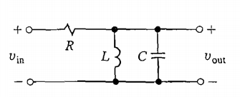
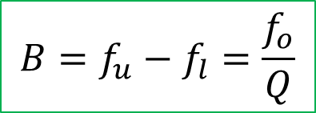
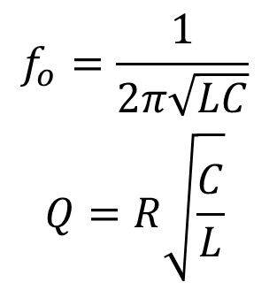
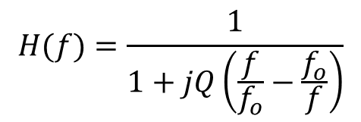
Bandpass transmission system
The simplest bandpass system is the parallel resonant or tuned circuit represented
$$H(f)=\frac{1}{1+jQ\left(\frac{f}{f_{o}}−\frac{f_{o}}{f}\right)}$$
Where fo is the resonant freq. and Q is the quality factor. These are related by
$$\begin{matrix}f_{o}=\frac{1}{2π\sqrt{LC}} \\ Q=R\sqrt{\frac{C}{L}}\end{matrix}$$
The 3 dB bandwidth between the lower and upper cutoff frequencies
$$B=f_{u}−f_{l}=\frac{f_{o}}{Q}$$
Notes:
Transfer function $H(f)=\frac{1}{1+jQ\left(\frac{f}{f_{o}}−\frac{f_{o}}{f}\right)}$
The fractional bandwidth should be kept within the range of
$$0.01<\frac{B}{f_{c}}<0.1$$
Otherwise the serious signal distortion can occur

Slide 32
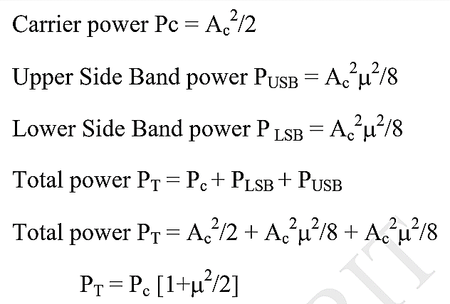
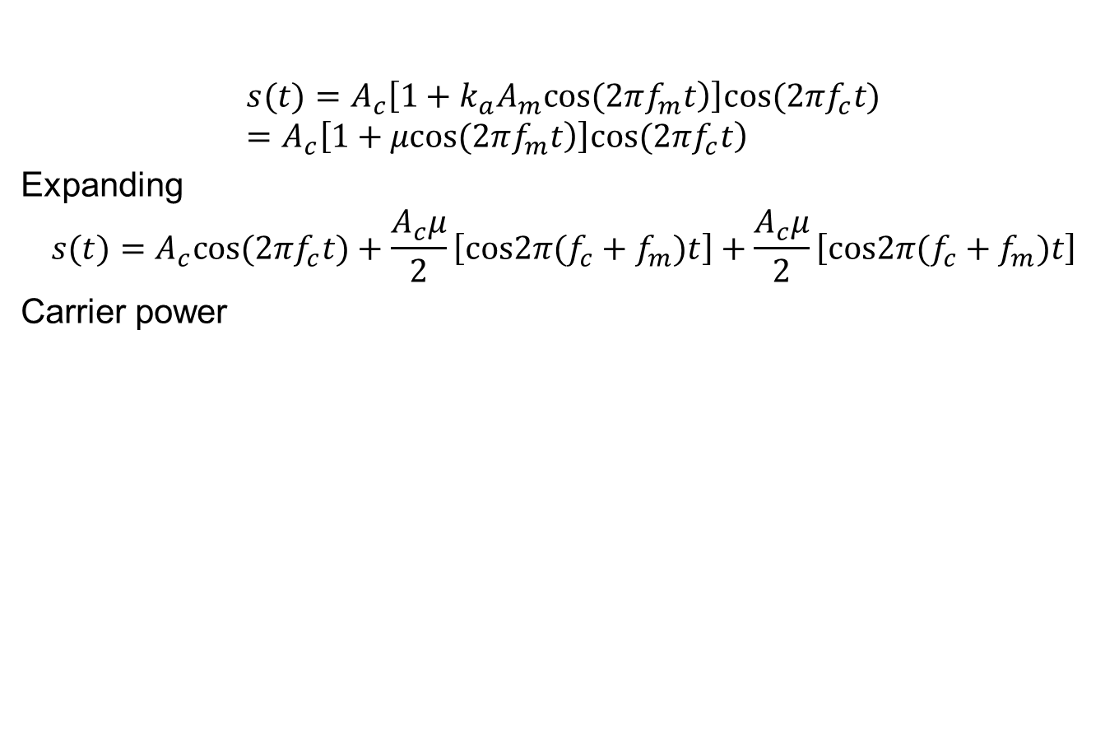
AM Detailed power calculation
$$\left.s(t)=A_{c}\left[\left.1+k_{a}A_{m}cos(2πf_{m}t\right)\right]cos(2πf_{c}t)=A_{c}\left[\left.1+μcos(2πf_{m}t\right)\right]cos(2πf_{c}t\right)$$
Expanding
$$s(t)=A_{c}cos(2πf_{c}t)+\frac{A_{c}μ}{2}\left[cos2π(f_{c}+f_{m})t\right]+\frac{A_{c}μ}{2}\left[cos2π(f_{c}+f_{m})t\right]$$
Carrier power

Slide 33
Virtues and limitation of Conventional AM
Generation and detection is very easy
It is very cheap to build.
AM is wasteful of power
Due to transmission of carrier wave which is independent of intelligent signal
AM is wasteful of bandwidth
The transmission of both upper and lower sideband which are uniquely related by virtue of their symmetry about the fc, one can be determined from the other.

Slide 34
Generation of AM waves
AM wave generation requires two basic methods
Square-Law modulator
Switching modulator
Others
Balanced modulator (Square Law variant)
Ring Modulator (Switching variant)
etc

Slide 35
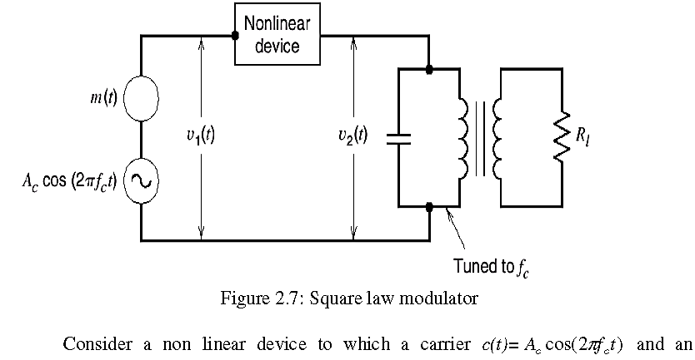
Square-law modulator
Notes:
What’s a nonlinear device?

Slide 36
Square-law modulator
Square-law modulator consist of
Summer: It adds the carrier and the modulating signal
Non-linear device: a device with non-linear i/p –o/p relation
Band-pass filter (BPF): This extract the deserved signal from the modulator product
The total i/p signal is
Notes:
$$V_{o}=a_{o}+a_{1}V_{in}+a_{2}V_{in}^{2}+a_{3}V_{in}^{3}+...$$

Slide 37
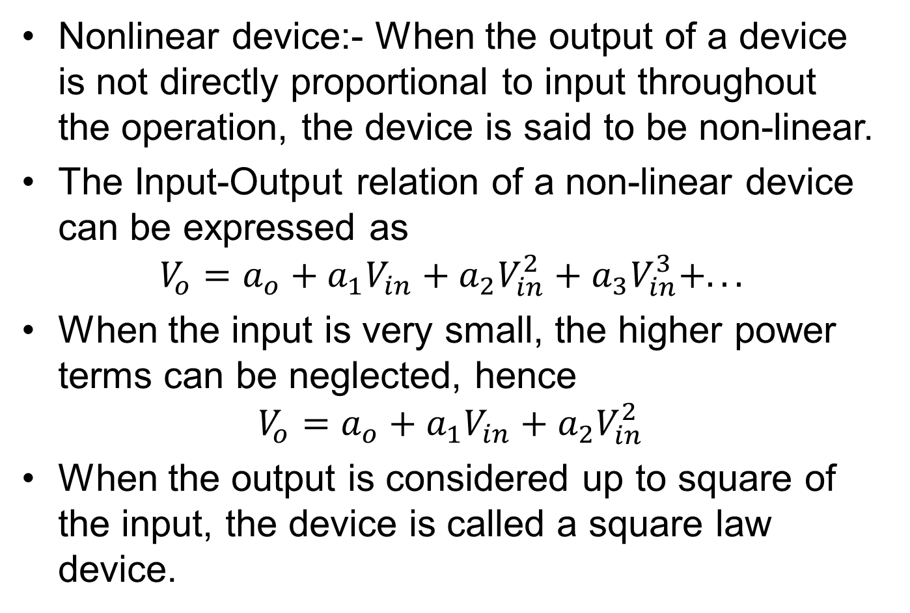
Square-law modulator
Nonlinear device:- When the output of a device is not directly proportional to input throughout the operation, the device is said to be non-linear.
The Input-Output relation of a non-linear device can be expressed as
$$V_{o}=a_{o}+a_{1}V_{in}+a_{2}V_{in}^{2}+a_{3}V_{in}^{3}+...$$
When the input is very small, the higher power terms can be neglected, hence
$$V_{o}=a_{o}+a_{1}V_{in}+a_{2}V_{in}^{2}$$
When the output is considered up to square of the input, the device is called a square law device.
Notes:
The a’s are constant

Slide 38
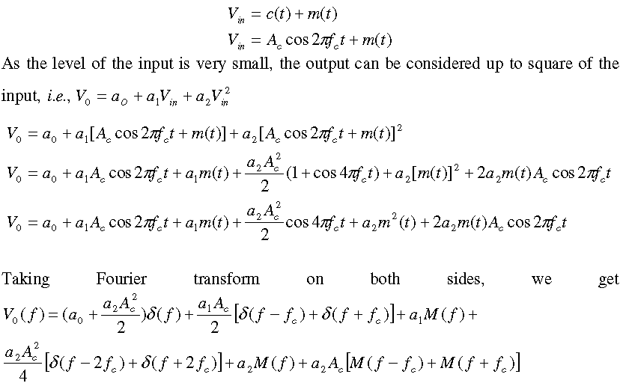
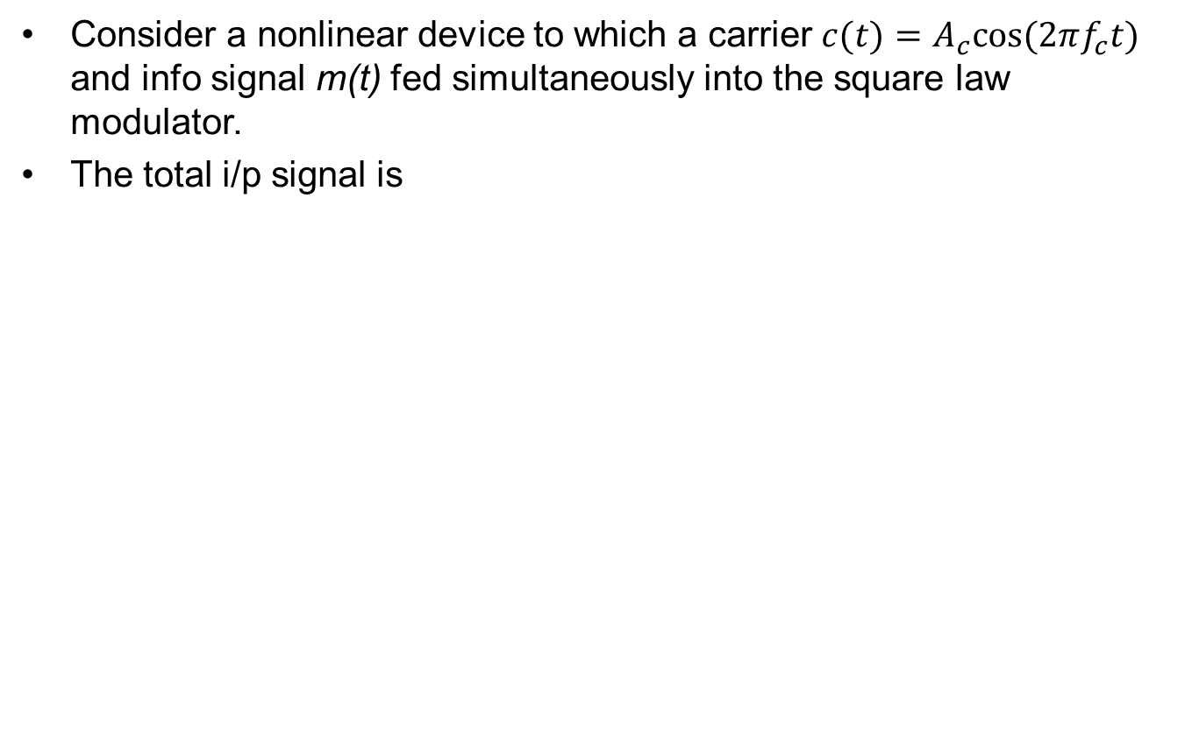
Square-law modulator
Consider a nonlinear device to which a carrier $c(t)=A_{c}cos(2πf_{c}t)$ and info signal m(t) fed simultaneously into the square law modulator.
The total i/p signal is
Notes:
$$c(t)=A_{c}cos(2πf_{c}t$$

Slide 39
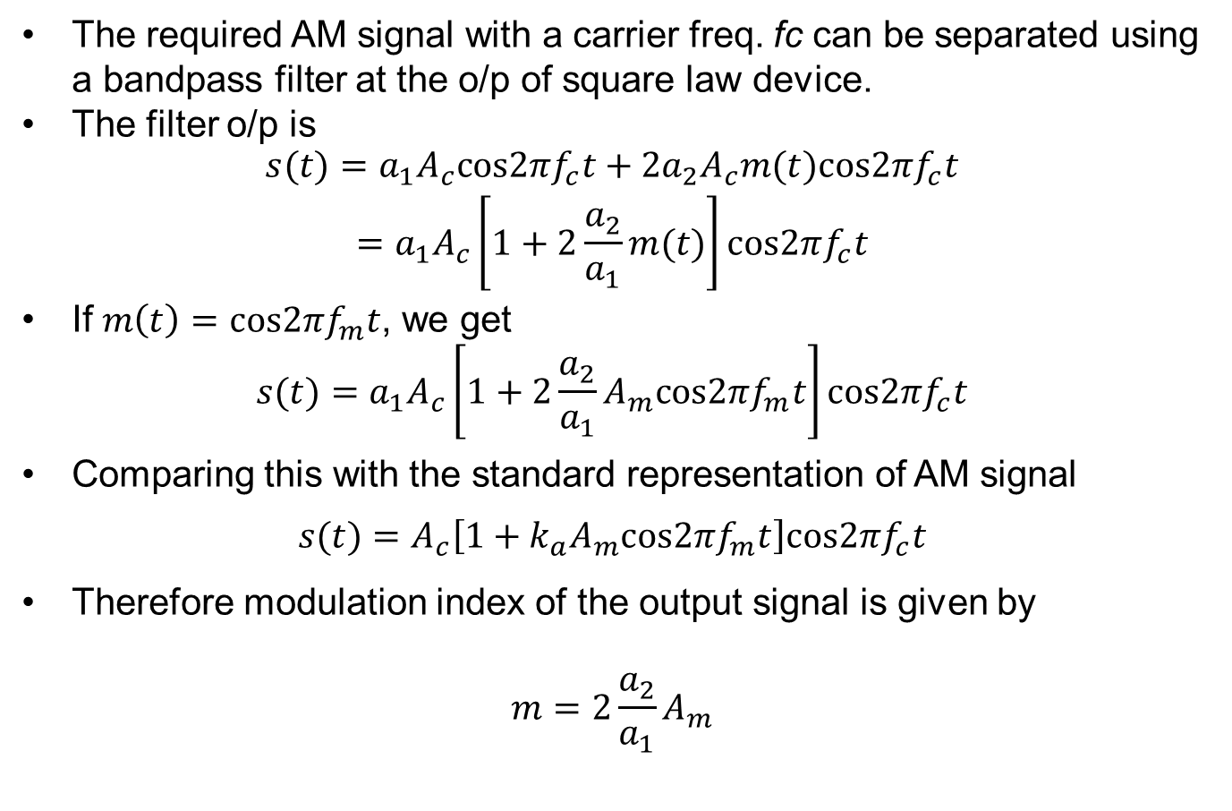
Square-law modulator
The required AM signal with a carrier freq. fc can be separated using a bandpass filter at the o/p of square law device.
The filter o/p is
$$\begin{matrix}s(t)=a_{1}A_{c}cos2πf_{c}t+2a_{2}A_{c}m(t)cos2πf_{c}t \\ =a_{1}A_{c}\left[1+2\frac{a_{2}}{a_{1}}m(t)\right]cos2πf_{c}t\end{matrix}$$
If $m\left(t\right)=cos2πf_{m}t$, we get
$$s(t)=a_{1}A_{c}\left[1+2\frac{a_{2}}{a_{1}}A_{m}cos2πf_{m}t\right]cos2πf_{c}t$$
Comparing this with the standard representation of AM signal
$$s(t)=A_{c}\left[1+k_{a}A_{m}cos2πf_{m}t\right]cos2πf_{c}t$$
Therefore modulation index of the output signal is given by
$$m=2\frac{a_{2}}{a_{1}}A_{m}$$
Notes:
$$m=2\frac{a_{2}}{a_{1}}A_{m}$$

Slide 40
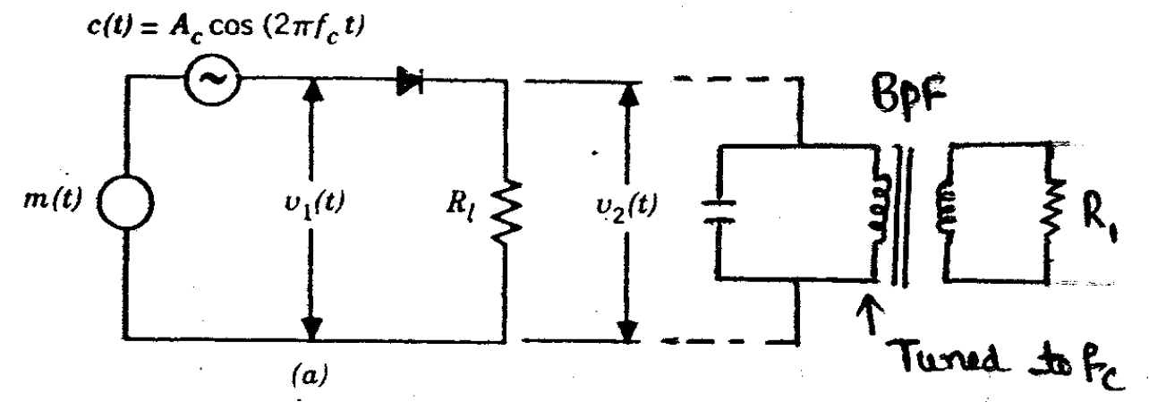
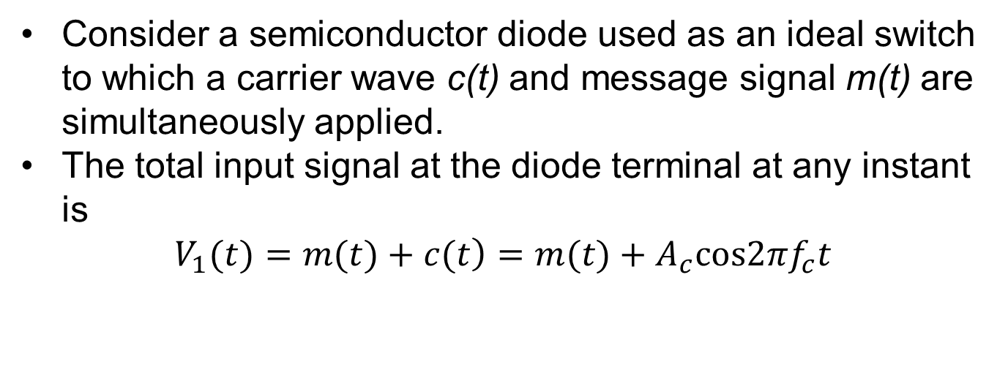
Switching modulator
Consider a semiconductor diode used as an ideal switch to which a carrier wave c(t) and message signal m(t) are simultaneously applied.
The total input signal at the diode terminal at any instant is
$$\left.V_{1}(t)=m(t)+c(t\right)=m(t)+A_{c}cos2πf_{c}t$$

Slide 41
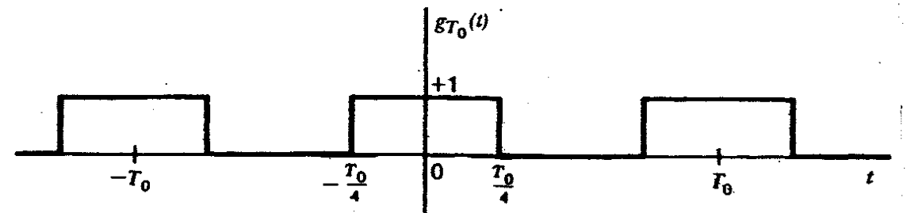
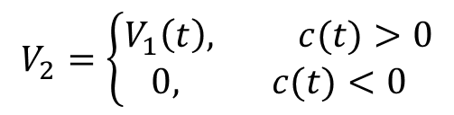
Switching modulator
When the peak amplitude of c(t) is maintained more than that of information signal, the operation is assumed to be dependent on only c(t) irrespective of m(t).
When c(t) is positive, v2 = v1 since the diode is forward biased.
Similarly, when c(t) is negative, v2 = 0 since diode is reverse biased.
Based upon the above operation, switching response of the diode is periodic rectangular wave with an amplitude of unity.
The o/p of the diode is
$$V_{2}=\left\{\begin{matrix}V_{1}\left(t\right), c(t)>0 \\ 0, c(t)<0\end{matrix}\right.$$

Slide 42
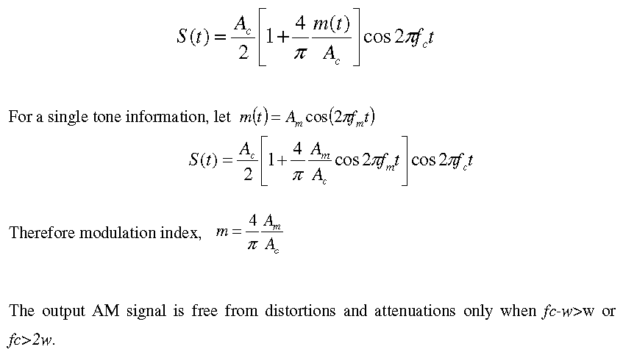
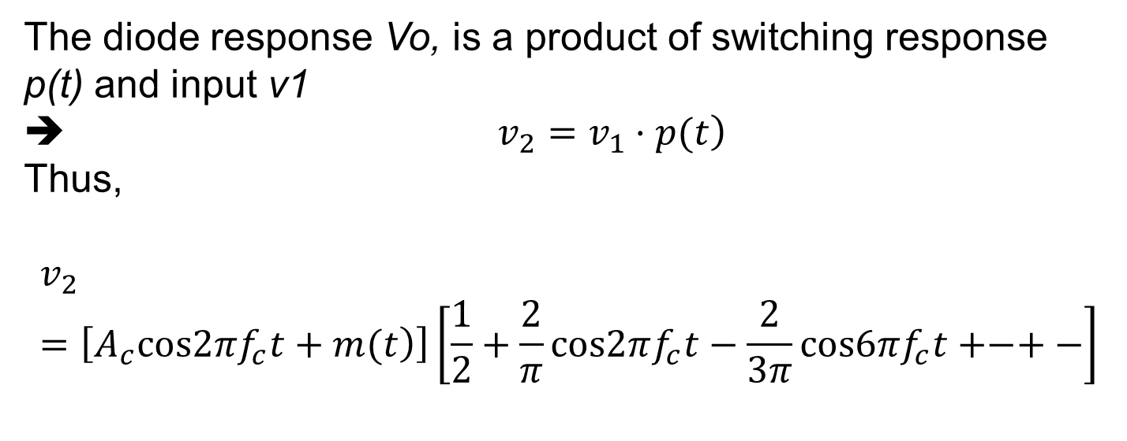
Switching modulator
The diode response Vo, is a product of switching response p(t) and input v1
➔ $\left.v_{2}=v_{1}·p(t\right)$
Thus,
$$v_{2}=\left[\left.A_{c}cos2πf_{c}t+m(t\right)\right]\left[\frac{1}{2}+\frac{2}{π}cos2πf_{c}t−\frac{2}{3π}cos6πf_{c}t+−+−\right]$$
The required AM signal centered at fc can be separated using band pass filter.
.
The filter output is given by the ff equation
Notes:
$$v_{2}=\left[\left.A_{c}cos2πf_{c}t+m(t\right)\right]\left[\frac{1}{2}+\frac{2}{π}cos2πf_{c}t−\frac{2}{3π}cos6πf_{c}t+−+−\right]$$

Slide 43
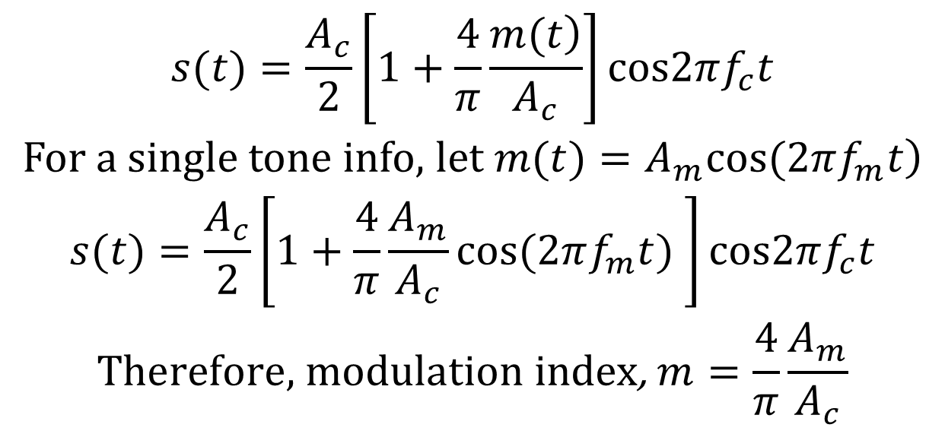
Switching modulator
The required AM signal centered at fc can be separated using band pass filter.
The filter output is given by
$$\begin{matrix}s(t)=\frac{A_{c}}{2}\left[1+\frac{4}{π}\frac{\left.m(t\right)}{A_{c}}\right]cos2πf_{c}t \\ \left.\text{For} \text{a} \text{single} \text{tone} \text{info}\text{, }\text{let} m(t)=A_{m}cos(2πf_{m}t\right) \\ s(t)=\frac{A_{c}}{2}\left[1+\frac{4}{π}\frac{A_{m}}{A_{c}}cos(2πf_{m}t) \right]cos2πf_{c}t \\ \text{Therefore}\text{, }\text{modulation} \text{index}\text{, }m=\frac{4}{π}\frac{A_{m}}{A_{c}}\end{matrix}$$
Notes:
The lower cutoff-frequency for the band pass filter should be between w and fc – w and the upper cut-off frequency between fc + w and 2fc.
$$v_{2}=\left[\left.A_{c}cos2πf_{c}t+m(t\right)\right]\left[\frac{1}{2}+\frac{2}{π}cos2πf_{c}t−\frac{2}{3π}cos6πf_{c}t+−+−\right]$$

Slide 44
AM Demodulation – Envelop detector
Demodulation is the process of recovering the information signal (baseband) from the incoming modulated signal at the receiver.
There are two methods:
Square law demodulator and
Envelop detector

Slide 45
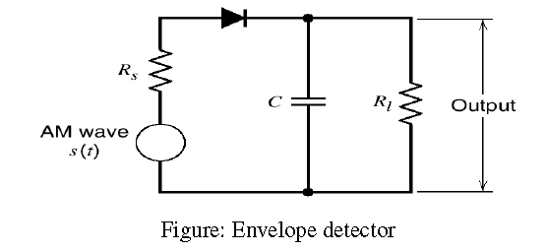
AM Demodulation – Envelop detector
Envelope detector is a simple and highly effective device use to demodulate AM wave.
It consist of diode and a resistor capacitor (RC) filter

Slide 46
AM Demodulation – Envelop detector
During the positive half cycles of the input signals, the diode D is forward biased and the capacitor C charges up quickly to the peak of the input signal.
When the input signal falls below this value, the diode becomes reverse biased and the capacitor C discharges through the load resistor RL.
The discharge process continues until the next positive half cycle.
When the input signal becomes greater than the voltage across the capacitor, the diode conducts again and the process is repeated.

Slide 47
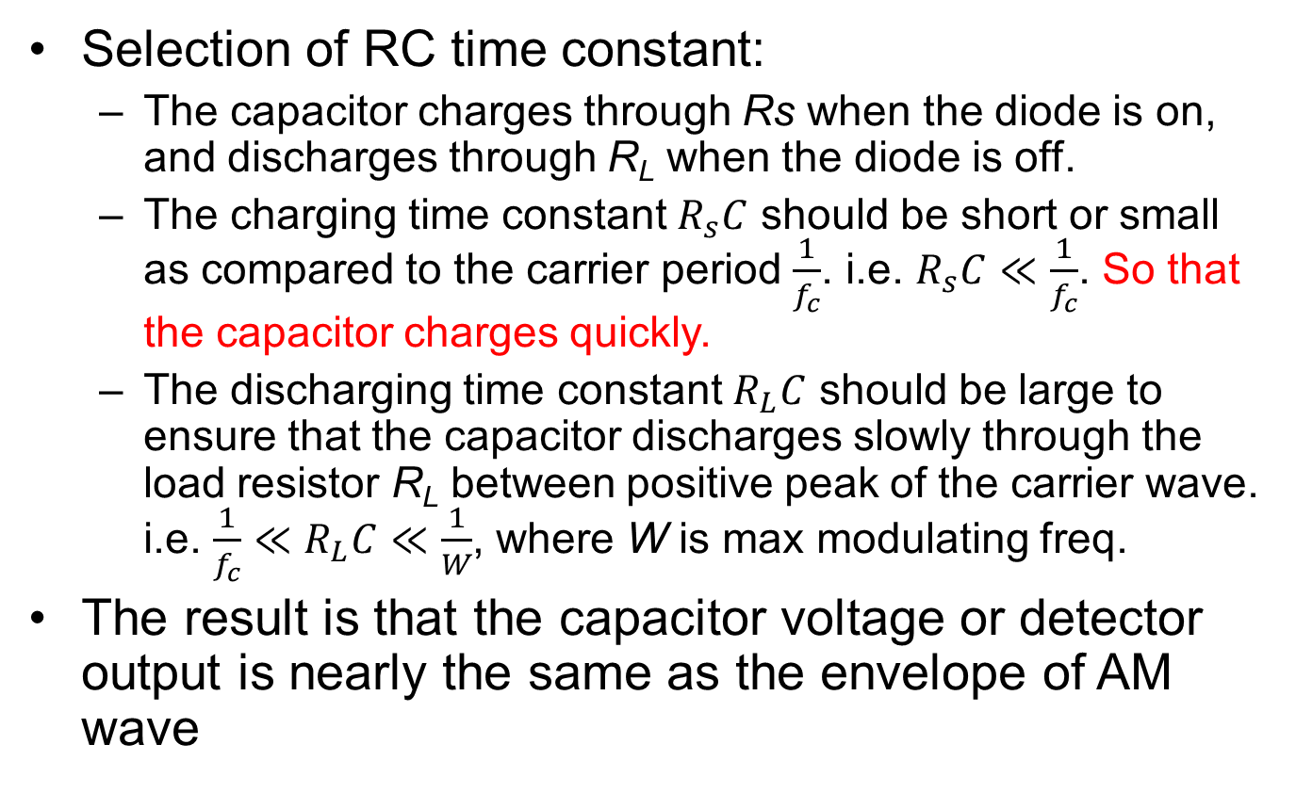
AM Demodulation – Envelop detector
Selection of RC time constant:
The capacitor charges through Rs when the diode is on, and discharges through R_{L} when the diode is off.
The charging time constant $R_{s}C$ should be short or small as compared to the carrier period $\frac{1}{f_{c}}$. i.e. $R_{s}C≪\frac{1}{f_{c}}$. So that the capacitor charges quickly.
The discharging time constant $R_{L}C$ should be large to ensure that the capacitor discharges slowly through the load resistor R_{L} between positive peak of the carrier wave. i.e. $\frac{1}{f_{c}}≪R_{L}C≪\frac{1}{W}$, where W is max modulating freq.
The result is that the capacitor voltage or detector output is nearly the same as the envelope of AM wave
Notes:
$$\frac{1}{f_{c}}≪R_{L}C≪\frac{1}{W}$$

Slide 48
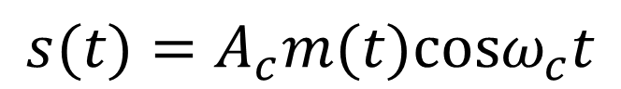
DSB-SC Modulation
DSB-SC is obtained by product modulator that simply multiples the message signal m(t) by the carrier wave
$$s(t)=A_{c}m(t)cosω_{c}t$$

Slide 49



DSB-SC Modulation
$$s(t)=A_{c}m(t)cosω_{c}t$$
The modulated signal s(t) undergoes phase reversal whenever the message signal m(t) crosses zero

Slide 50

Example
Suppose that the modulating signal m(t) is a sinusoid of the form
$$m\left(t\right)=acosωt; f_{m}≪f_{c}$$
Determine the DSB-SC AM signal and its upper and lower sidebands.
Take $\left.c(t)=A_{c}cos(2πf_{c}t+φ_{c}\right)$
Notes:
Handout page 44

Slide 51

Self-check
A signal m(t) bandlimited to 5 kHz is DSB modulated by $cos\left(2πf_{c}t+φ_{c}\right)$ to yield s(t). For what value of carrier frequency fc, will the bandwidth of s(t) be 2% of fc

Slide 52

Power content of DSB-SC signal
Taking the DSB signal, $s\left(t\right)=A_{c}m\left(t\right)cos{(ω}_{c}t+φ_{c})$ the power content can be calculated by taking time-average autocorrelation function as
$$R_{u}(τ)=\lim_{T→∞}\frac{1}{T}\int_{−T/2}^{T/2}{u(t)u(t−τ)dt}$$
$$R_{u}(τ)=\frac{A_{c}^{2}}{2}R_{m}(τ)cos(2πf_{c}τ)$$
FT of $R_{u}(τ)$ gives
$$S_{u}(f)=\frac{A_{c}^{2}}{4}\left[\left.S_{m}(f−f_{c})+S_{m}(f+f_{c}\right)\right]$$
The power-spectral density of the DSB-SC signal is the power- spectral density of the message shifted upward and downward by fc and scaled by $\frac{A_{c}^{2}}{2}$
Notes:
Next Total power of DSB

Slide 53

Power content of DSB-SC signal
The total power of DSB signal can be found by setting $τ=0$ in the autocorrelation function or
The power can be determined by integrating $S_{u}(f)=\frac{A_{c}^{2}}{4}\left[\left.S_{m}(f−f_{c})+S_{m}(f+f_{c}\right)\right]$ over all frequency components.
Using $R_{u}(τ)=\frac{A_{c}^{2}}{2}R_{m}(τ)cos(2πf_{c}τ)$ for $τ=0$ gives
$$\begin{matrix}P_{u}=\frac{A_{c}^{2}}{2}{\left.R_{m}(τ)cos(2πf_{c}τ\right)|}_{τ=0} \\ =\frac{A_{c}^{2}}{2}R_{m}(0)=\frac{A_{c}^{2}}{2}P_{m}\end{matrix}$$
Where $R_{m}(0)=P_{m}$ is the power of the message signal

Slide 54

Self-check
Determine the power-spectral density of the modulated signal, the power in the modulated signal, and the power in each of the sidebands. Given the modulated signal as
$$\left.s(t)=A_{c}A_{m}cos(ω_{m}t)cos(ω_{c}t+φ_{c}\right)$$
Notes:
$$\left.s(t)=A_{c}A_{m}cos(ω_{m}t)cos(ω_{c}t+φ_{c}\right)$$

Slide 55

Demodulation of DSB-SC
In the absence of noise and ideal channel, the received signal is equal to the modulated signal
$$\left.r(t)=u(t)=A_{c}m(t)cos(2πf_{c}t+φ_{c}\right)$$
Demodulation is done by multiplying r(t) by a sinusoid $cos\left(2πf_{c}t+φ\right)$
Pass the resulting signal through ideal LPF with bandwidth W
$$\left.⇒r(t)cos(2πf_{c}t+φ)=A_{c}m(t)cos(2πf_{c}t+φ_{c})·cos(2πf_{c}t+φ\right) =\frac{1}{2}A_{c}m(t)cos(φ_{c}−φ)+\frac{1}{2}A_{c}m(t)cos(4πf_{c}t+φ+φ_{c})$$

Slide 56

Demodulation of DSB-SC
$$\left.⇒r(t)cos(2πf_{c}t+φ)=A_{c}m(t)cos(2πf_{c}t+φ_{c})·cos(2πf_{c}t+φ\right) =\frac{1}{2}A_{c}m(t)cos(φ_{c}−φ)+\frac{1}{2}A_{c}m(t)cos(4πf_{c}t+φ+φ_{c})$$
The LPF rejects higher freqs.
Hence, the o/p is
$$y_{l}(t)=\frac{1}{2}A_{c}m(t)cos(φ_{c}−φ)$$
How do we recover the intelligent signal from this received signal with phase difference $(φ_{c}−φ)$ or the factor $cos(φ_{c}−φ)$?
We require phase-coherent or synchronous demodulator to recover message signal m(t) from the received signal. → $(φ_{c}=φ)$
This is done by adding a carrier component called “pilot tone” to the transmitted signal in a phase-locked technique
Another way is to use phase-locked loop at the receiver end

Slide 57

Demodulation of DSB-SC
Coherent detector
The message signal m(t) can be uniquely recovered from a DSBSC wave s(t) by first multiplying s(t) with a locally generated sinusoidal wave and then low pass filtering the product as shown.
It is assumed that the local oscillator signal is exactly coherent or synchronized, in both frequency and phase, with the carrier wave c(t) used in the product modulator to generate s(t).
This method of demodulation is known as coherent detection or synchronous detection.

Slide 58

Demodulation of DSB-SC

Slide 59

Demodulation of DSB-SC
From the spectrum, it is clear that the unwanted component (first term in the expression) can be removed by the low-pass filter, provided that the cut-off frequency of the filter is greater than W but less than 2fc-W.
The filter output is given by

Slide 60

Demodulation of DSB-SC
Costas receiver or Costas loop
Costas receiver is a synchronous receiver system, suitable for demodulating DSBSC waves. It consists of two coherent detectors supplied with the same input signal but with individual local oscillator signals that in phase quadrature w.r.t. to each other as indicated in the image above
Notes:
Costas receiver is a synchronous receiver system, suitable for demodulating DSBSC waves. It consists of two coherent detectors supplied with the same input signal but with individual local oscillator signals that in phase quadrature w.r.t. to each other as indicated in the image above

Slide 61
DSB-SC
Advantages
Low Power consumption or power saying.
The modulation system is simple.
Efficiency is more than AM
Carrier wave is suppressed
Linear modulation type is required
It can be used for point to point communication
Disadvantages
Design o f receiver is complex
Bandwidth required is same as that o f AM
Application
Analogue TV systems to transmit color information

Slide 62
Single side-band suppressed carrier modulation (SSB-SC)
Standard AM and DSB-SC require transmission bandwidth equal to twice the message bandwidth.
In both cases, the spectrum contains two side bands of width W Hz, each.
However, the upper and lower sides are uniquely related to each other by the virtue of their symmetry about the carrier frequency.
That is, given the amplitude and phase spectra of either side band, the other can be uniquely determined.
No information is lost when only one side band is transmitted, and both the carrier and the other side band are suppressed at the transmitter.
This kind of modulation is called SSB-SC

Slide 63

Single side-band suppressed carrier modulation (SSB-SC)
The selection of the sideband is done by using Hilbert transform filter

Slide 64

Assignment
Consider a message signal $\left.m(t)=20cos(2πt\right)$V and a carrier signal $\left.c(t)=50cos(100πt\right)$V
Find the resulting AM wave for 75% modulation
Sketch the spectrum of this AM wave
Find the power developed across a load of 150 Ω
Notes:
$$\left.c(t)=50cos(100πt\right)$$

Slide 65
Assignment
An AM signal has the form u(t) = [20 + 2cos3000πt + 10cos6000πt]cos2πf_{c}t, where f_{c} = 10⁵Hz.
Sketch the spectrum of u(t)?
Determine the power in each of the frequency components?
Determine the modulation index?
Determine the power in the sidebands, the total power, and the ratio of the sidebands power to the total power?
Notes:
$$\left.c(t)=50cos(100πt\right)$$

Slide 66
Angle Modulation FM & PM

Slide 67

Angle modulation
Angle modulation is a method of analog modulation in which either the phase or frequency of the carrier wave is varied according to the message signal.
In this method of modulation the amplitude of the carrier wave is maintained constant.
Let $\left.θ_{i}(t\right)$ denote the angle of modulated signal sinusoidal carrier, assumed to be a function of the message signal.
In general, angle modulated signal is of the form
$$s(t)=A_{c}cos\left[\left.θ_{i}(t\right)\right]$$
Notes:
$$s(t)=A_{c}cos\left[\left.θ_{i}(t\right)\right]$$

Slide 68

Angle modulation
Where Ac is the amplitude of the carrier wave and
$\left.θ_{i}(t)=2πf_{c}t+φc(t\right)$
is the angle of the modulated carrier and also the function of the message signal.
The instantaneous frequency of the angle modulated signal, s(t) is given by
$$f_{i}(t)=\frac{1}{2π}\frac{\left.dθ_{i}(t\right)}{dt}$$
Notes:
$$f_{i}(t)=\frac{1}{2π}\frac{\left.dθ_{i}(t\right)}{dt}$$

Slide 69

Angle modulation
Since s(t) is a bandpass signal, it can be represented as $s(t)=A_{c}cos\left(\left.2πf_{c}t+φ(t\right)\right)$
The instantaneous frequency of the angle modulated signal, s(t) is given by
$$f_{i}\left(t\right)=f_{c}+\frac{1}{2π}\frac{d}{dt}φ(t)$$
If m(t) is the message signal, then in a PM system we have
$$φ\left(t\right)=k_{p}m\left(t\right)$$
and in FM, we have
$$f_{i}(t)−f_{c}=k_{f}m(t)=\frac{1}{2π}\frac{d}{dt}φ(t)$$
Where k_{p} and k_{f} are phase and freq, deviation constant
Notes:
$φ(t)$ is the phase of the signal

Slide 70


Angle modulation
Comparison of PM and FM modulators
We can then write this from the above analysis
$$φ(t)=\left\{\begin{matrix}k_{p}m(t), & PM \\ 2πk_{f}\int_{−∞}^{t}{m(τ)dτ,} & FM\end{matrix}\right.$$
There are two commonly used methods of angle modulation: 1. Frequency Modulation, and 2. Phase Modulation.
Notes:
$φ(t)$ is the phase of the signal

Slide 71


Example – Deriving PM & FM waves
A message signal is given by $m(t)=A_{m}cos(2πf_{m}t)$ is used to either freq. modulate or phase modulate a carrier $c(t)=A_{c}cos(2πf_{c}t)$. Find the modulated signal in each case
Solution. Using
$$φ(t)=\left\{\begin{matrix}k_{p}m(t), & PM \\ 2πk_{f}\int_{−∞}^{t}{m(τ)dτ,} & FM\end{matrix}\right.$$
Solution continues on the board
Notes:
$$c(t)=A_{c}cos(2πf_{c}t$$

Slide 72

Frequency modulation
Taking the general FM wave
$$s(t)=A_{c}cos\left[\left.2πf_{c}t+βsin(2πf_{m}t\right)\right]$$
And the angle of modulated carrier is
$\left.θ_{i}(t)=2πf_{c}t+φc(t\right)$
➔$θ_{i}(t)=2πf_{c}t+βsin(2πf_{m}t)$
Depending on the value of mod. index $β$, we get two cases of FM
Narrowband FM → $β$ << compared to one radian (ie $β$ << 1) or $φc(t)$ << 1
Wideband FM → $β$ >> compared to one radian (ie $β$ >> 1) or $φc(t)$ >> 1
Notes:
$$s(t)=A_{c}cos\left[\left.2πf_{c}t+βsin(2πf_{m}t\right)\right]$$

Slide 73

Narrowband FM
Taking the general FM wave
$$s(t)=A_{c}cos\left[\left.2πf_{c}t+βsin(2πf_{m}t\right)\right]$$
If m(t) and k_{f} are such that for all t, $φc(t)$ << 1, then we can expand and simplifying s(t) to a simple approximation as
$$\left.s(t)=A_{c}cos2πf_{c}t−βA_{c}sin(2πf_{c}t)sin(2πf_{m}t\right)$$
This is an approximate form of a narrowband FM wave produce by a sinusoidal modulating signal, $A_{m}cos2πf_{m}t$
Notes:
$$\left.s(t)=A_{c}cos2πf_{c}t−βA_{c}sin(2πf_{c}t)sin(2πf_{m}t\right)$$

Slide 74

Narrowband FM
Using trig. identities, s(t) is
$s(t)=A_{c}cos2πf_{c}t+\frac{βA_{c}}{2}\left[cos\left(2π(f_{c}+f_{m})t\right)−cos\left(2π(f_{c}−f_{m})t\right)\right]$
The above equation represents the NB-FM signal.
This representation is similar to an AM signal, except that the lower side frequency has negative sign.
Notes:
$$s(t)=A_{c}cos2πf_{c}t+\frac{βA_{c}}{2}\left[cos\left(2π(f_{c}+f_{m})t\right)−cos\left(2π(f_{c}−f_{m})t\right)\right]$$

Slide 75

Narrowband FM
The magnitude spectrum of NB-FM signal is as shown below, → this is similar to AM signal spectrum.
The bandwidth of the NB-FM signal is 2f_{m}, which is same as AM signal
Notes:
$$s(t)=A_{c}cos2πf_{c}t+\frac{βA_{c}}{2}\left[cos\left(2π(f_{c}+f_{m})t\right)−cos\left(2π(f_{c}−f_{m})t\right)\right]$$

Slide 76
We skip Wideband FM

Slide 77






Bessel function $\left.J_{n}(β\right)$
The plot below is $\left.J_{n}(β\right)$ for different n and $β$
$$J_{n}(β)=\frac{1}{2π}\int_{−π}^{π}{exp\left[j\left(βsinx−nx\right)\right]}dx$$
The equation for the complex envelop of FM (esp. WB-FM) is
$$\tilde{s}(t)=A_{c}\sum_{n=−∞}^{∞}{\left.J_{n}(β)exp(j2πnf_{m}t\right)}$$
Taking the real value of s(t), we get
$$s(t)=\sum_{n=−∞}^{∞}{A_{c}J_{n}(β)cos\left(2π(f_{c}+nf_{m})t\right)}$$
Note:
The angle-modulated signal contains all frequencies of the $f_{c}+nf_{m}$ for $n=0,±1,±2,...$
This means the actual bandwidth of the s(t) is infinite.
However, the amplitude for sinusoidal components with $f_{c}±nf_{m}$ for large n is small so effective bandwidth is define for s(t)
Notes:
$$n=0,±1,±2,...$$

Slide 78



Bessel function $\left.J_{n}(β\right)$
The plot below is $\left.J_{n}(β\right)$ for different n and $β$
$$J_{n}(β)=\frac{1}{2π}\int_{−π}^{π}{exp\left[j\left(βsinx−nx\right)\right]}dx$$

Slide 79



Bessel function $\left.J_{n}(β\right)$
The plot below is $\left.J_{n}(β\right)$ for different n and $β$
$$J_{n}(β)=\frac{1}{2π}\int_{−π}^{π}{exp\left[j\left(βsinx−nx\right)\right]}dx$$
Table of Bessel functions
Notes:
$$\tilde{s}(t)=A_{c}\sum_{n=−∞}^{∞}{\left.J_{n}(β)exp(j2πnf_{m}t\right)}$$

Slide 80

Power content of FM
The power content of FM carrier signal is given by
$$P_{c}=\frac{A_{c}^{2}}{2}$$
The power content of modulated carrier or FM wave is
$$P=\frac{A_{c}^{2}}{2}\sum_{n=−∞}^{∞}{\left.J_{n}^{2}(β\right)}$$
Notes:
For small value of B (beta) the function goes to 1

Slide 81
Example
Let the carrier be given by c(t) = 10cos(2πf_{c}t) and let the message signal be cos(20πt)
Further assume that the message is used to frequency modulate the carrier with k_{f} = 50.
Find the expression for the modulated signal and determine how many harmonics should be selected to contain 99% of the modulated signal power.
Solution on the board

Slide 82

Transmission bandwidth of FM
For FM signal generated by a single tone modulating signal of freq. f_{m}, we can define approximate rule for the transmission bandwidth using Carson’s rule →
$$B_{T}≃2Δf+2f_{m}=2Δf\left(1+\frac{1}{β}\right)=2(β+1)f_{m}$$
If the message signal is given by
$$\left.m(t)=A_{m}cos(2πf_{m}t\right)$$
$\text{The} \text{transmission} \text{bandwidth} \text{modulated} \text{signal} s(t) \text{is}$
$$B_{T}=2(β+1)f_{m}=\left\{\begin{matrix}2(k_{p}A_{m}+1)f_{m}, & PM \\ 2\left(\frac{k_{f}A_{m}}{f_{m}}+1\right)f_{m}, & FM\end{matrix}\right.=\left\{\begin{matrix}2(k_{p}A_{m}+1)f_{m}, & PM \\ 2\left(k_{f}A_{m}+f_{m}\right), & FM\end{matrix}\right.$$
Notes:
In theory, an FM signal contains an infinite number of side frequencies so that the bandwidth required to transmit such a signal is similarly infinite in extent. In practice, however, we find that the FM signal is effectively limited to a finite number of significant side frequencies compatible with a specified amount of distortion. We may therefore specify an effective bandwidth required for the transmission of an FM signal.

Slide 83


Example
Estimate B_{FM} for the modulating signal m(t) in the figure below for $k_{f}=2π×{10}^{5}$ and modulating freq. (W) of 15 kHz
Notes:
$$k_{f}=2π×{10}^{5}$$

Slide 84
Self-check
Repeat the problem of the example on the previous slide if the amplitude of m(t) is doubled [ie. if m(t) is multiplied by 2]
Notes:
$$k_{f}=2π×{10}^{5}$$

Slide 85



Self-check
An angle-modulated signal with carrier frequency $ω_{c}=2π×{10}^{5}$ is described by the equation
$$℘_{EM}(t)=10cos\left(ω_{c}t+5sin3000t+10sin2000πt\right)$$
Find the power of the modulated signal
Find frequency deviation $Δf$
Find the deviation ratio $β$
Find the phase deviation $Δφ$
Estimate the bandwidth of $℘_{EM}(t)$
Note: The bandwidth is 1000 Hz, the highest freq. in m(t)
→Find the instantaneous freq. first
By differentiation → $ω_{i}=\frac{d}{dt}θ(t)$
Find max carrier deviation → get freq. deviation
→ We need $θ(t)$
→ Carson’s formula
Notes:
Pulse to explain
Note: The bandwidth is 1000 Hz, the highest freq. in m(t)
The two sinusoidal you get after derivative could add up at some point in time → we take their amplitude and add
The sum of the amplitudes of the sinusoid gives the phase deviation

Slide 86

Example
Find the bandwidth of a single tone modulated FM signal described by $s(t)=10cos\left[\left.2π{10}^{8}t+6sin(2π{10}^{3}t\right)\right]$
Solution
Notes:
$$s(t)=10cos\left[\left.2π{10}^{8}t+6sin(2π{10}^{3}t\right)\right]$$

Slide 87
Angle modulators
One method for generating an FM signal directly is to design an oscillator whose frequency changes with the input voltage.
When the input voltage is zero, the oscillator generates a sinusoid with frequency fc, and when the input voltage changes, this frequency changes accordingly.
There are two approaches to designing such an oscillator, usually called a VCO or voltage-controlled oscillator. One approach is to use a varactor diode and reactance tube.
Others include indirect method which makes used of NB-FM signal

Slide 88

FM Generation cont’d
Voltage-Controlled Oscillator

Slide 89

Varactor diode VCO
A varactor diode is a capacitor whose capacitance changes with the applied voltage
If this capacitor is used in the tuned circuit of the oscillator and the message signal is applied to it, the frequency of the tuned circuit, and the oscillator, will change in accordance with the message signal
Simplified
Notes:
What is varactor diode?

Slide 90

Varactor diode VCO
Let set the inductor value to Lo the capacitance of the varactor diode as
$\left.C(t)=C_{o}+k_{o}m(t\right)$
Now, when m(t) = 0, the freq. of the tuned circuit is
$$f_{c}=\frac{1}{2π\sqrt{L_{o}C_{o}}}$$
In general for nonzero m(t)
Notes:
What is varactor diode?
$$f_{c}=\frac{1}{2π\sqrt{L_{o}C_{o}}}$$

Slide 91

Indirect Armstrong transmitter

Slide 92
Application of FM
Some of the applications of the FM modulation are listed below:
FM Radio,(88 -108 MHz band, 75 kHz)
TV sound broadcast, 25 kHz,
Two-way mobile radio, 5 kHz / 2.5 kHz.

Slide 93

Carrier
Intelligent signal
FM wave
PM wave

Slide 94
Advantages and disadvantages of FM over AM
Advantages of FM over AM are:
Less radiated power.
Low distortion due to improved signal to noise ratio (about 25dB) w.r.t. to man made interference.
Smaller geographical interference between neighboring stations.
Well defined service areas for given transmitter power.
Disadvantages of FM:
Much more Bandwidth (as much as 20 times as much).
More complicated receiver and transmitter.

Slide 95

Comparison of FM and AM
FM | AM
The modulation index can have value either less than one or more than one. | The value of modulation index is always between zero and one.
Since in FM, amplitude of the earner is constant, the transmitted power is constant, independent of the modulation index. | Transmitted power is dependent upon modulation index $P_{T}=P_{c}\left[1+\frac{m^{2}}{2}\right]$
The modulation index determines the number of significant pairs of sidebands in an FM signal. | In an AM signal, only two sidebands are produced, for any value of modulation index.
The amplitudes of the carrier and side bands vary with the modulation index and can be calculated with Bessel functions. | The amplitudes of the sidebands is dependent on the modulation index, and is always less than the amplitude of carrier.
The carrier or sideband amplitudes are zero at some modulation indices. | The sideband amplitude is never zero for any value of modulation index greater than zero.
The bandwidth of an FM signal is proportional to the modulation index. | The bandwidth of an AM signal is twice the highest modulating frequency.
For FM, the % of modulation is the ratio of the actual frequency deviation and the maximum.om permissible frequency deviation multiplied by 100. | For AM, % modulation is the ratio of amplitude of modulating voltage to the amplitude of the carrier multiplied by 100.
Notes:
$$P_{T}=P_{c}\left[1+\frac{m^{2}}{2}\right]$$

Slide 96
Comparison of FM and AM
FM | AM
The main advantage of FM over AM is its noise immunity, as limiter stage in FM receiver clips off noise signals. | The AM system is more susceptible to noise and more affected by noise than FM.
The capture effect in FM allows the strongest signal on a frequency to dominate without interference from the other signal. | When two AM signals occupy the same frequency, both signals will generally be heard regardless of their relative signal strength.
In FM, greater transmitter efficiency can be realized using class-C amplifiers, as amplitude of FM signal is constant. | The efficiency of AM is less than that of FM due to use of class-B amplifier.
The bandwidth of FM signal is much under than the bandwidth of AM. The bandwidth of a typical FM channel is 200 kHz. | The bandwidth required to transmit AM signal is much less than that of FM typically 10 kHz in AM broadcasting.
Notes:
$$P_{T}=P_{c}\left[1+\frac{m^{2}}{2}\right]$$

